Slide 1

SAMIS Login Changes
Multifactor Authentication is Coming Soon to SAMIS!
What you need to know.

Slide 2
What is Multifactor Authentication (MFA)?
MFA adds an extra layer of security by requiring two factors to verify your identity.
1
Something you know – Your username and password
2
Something you have – Your mobile phone (for a one-time text message (SMS) code)
3

Slide 3

Why is MFA Important?
Cybercriminals target accounts with weak or stolen passwords. MFA helps protect your data by:
Preventing unauthorized access – Even if someone knows your password, they can’t access your account without your text message code.
Keeping your information secure – Safeguarding sensitive data and protecting against password theft phishing attacks. MFA makes it harder for an attacker to access sensitive data.
Did you know? 99% of account hacks could be prevented by using multifactor authentication! (Source: Microsoft)

Slide 4
What You Need to Do
During the month of February, all users of SAMIS will be required to:
Register a mobile phone number within SAMIS.
After March 1st, all users of SAMIS will:
Use a mobile phone to receive a text message with a one-time code when logging in.

Slide 5
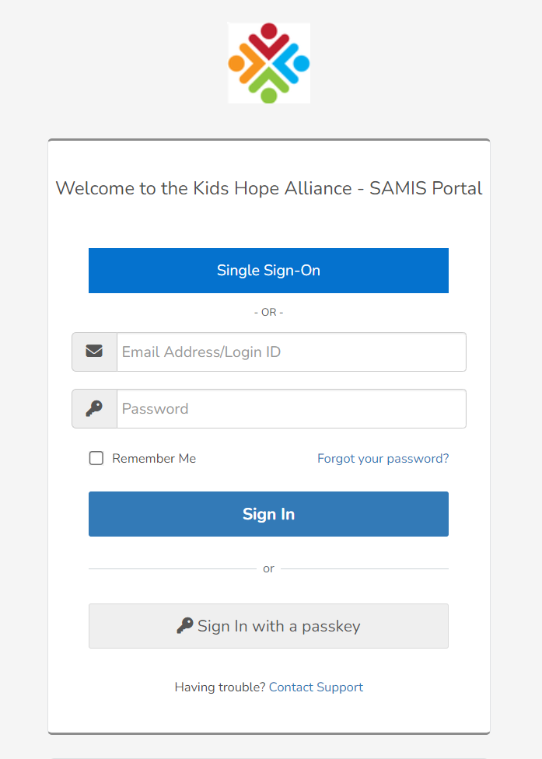
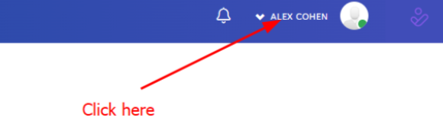
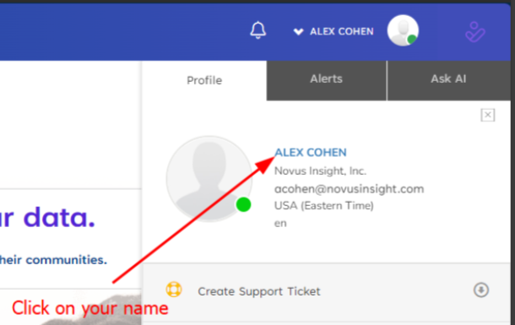
How do I register for MFA?
1. Log into SAMIS with your username and password.
2. In the upper right corner, find your name, and click the drop-down menu.
3. Under the “Profile” tab, click your name.

Slide 6
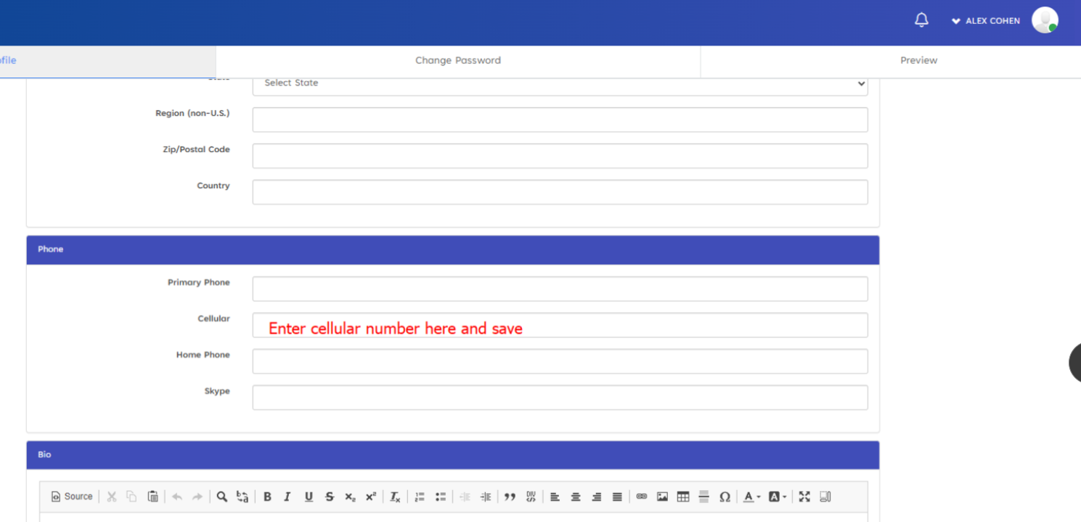
How do I register for MFA?
4. Scroll down to the “Phone” section and enter your cellular/mobile phone number. Save the changes.
This completes the registration process.
You won’t notice any changes until MFA is enforced by KHA in March.

Slide 7

What Happens in March?
In March, KHA will enforce MFA on all SAMIS logins. The next slides detail what you will experience when MFA is enforced.

Slide 8
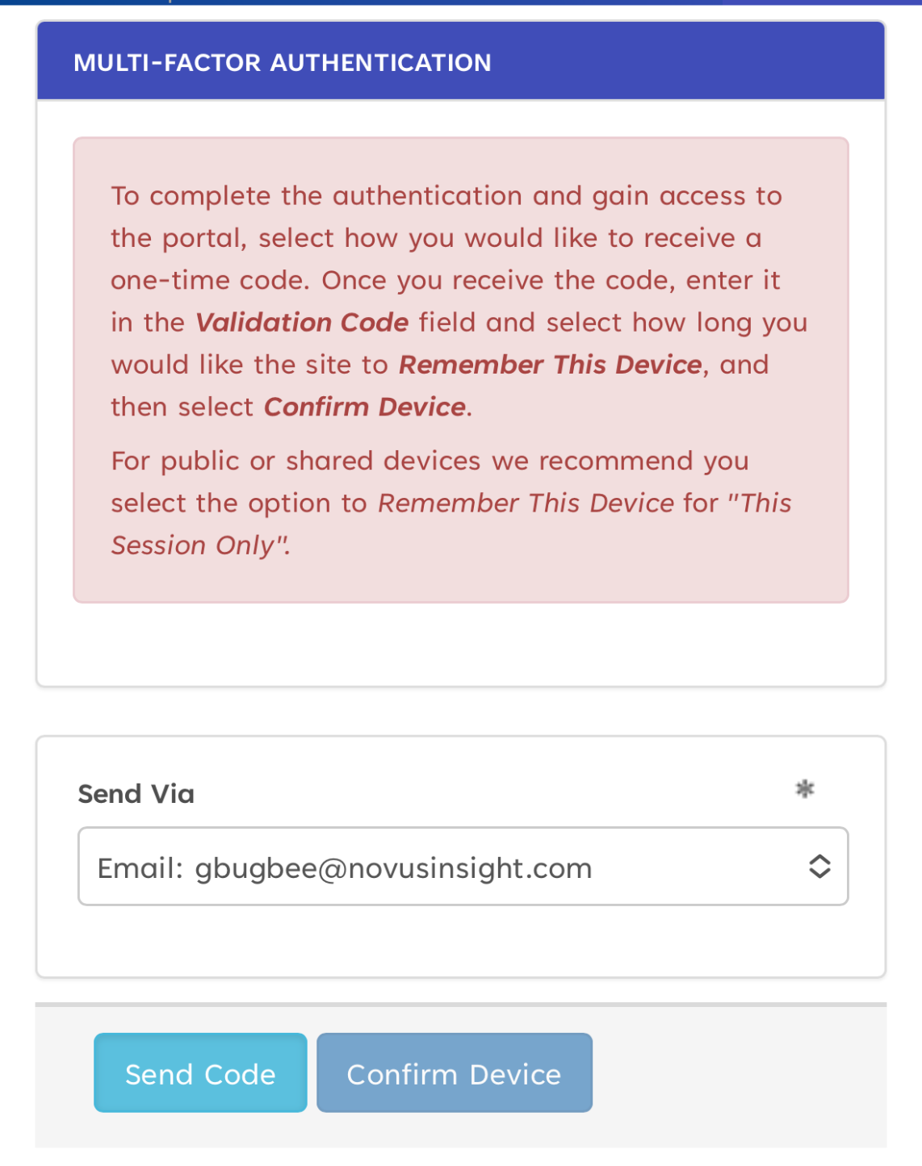
How does my login change?
After you enter your username and password, you will be prompted for multifactor authentication.
Please note, although email is an option, email is not a secure method of MFA- if your email is compromised, an attacker could gain access to your MFA codes.
Select the “Send Via” drop down.

Slide 9
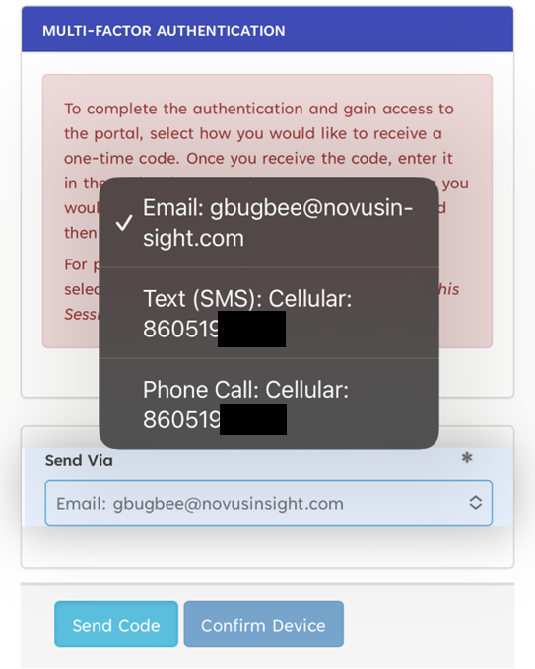
How does my login change?
Choose the option for Text (SMS)
You will receive a code that you will then enter.
You can choose to confirm your device for a duration of time so that you are not prompted each time for MFA.

Slide 10
FAQs
Q: Why do I have to use my phone?
A: Your phone is a secure, personal device that ensures only you can access your account. It’s an effective way to stop unauthorized logins.
Q: What if I don’t have my phone with me?
A: You can use the “email option” as a backup method, but please do not use it as a primary form of MFA
Q: Will I have to do this every time I log in?
A: You’ll need the SMS code when signing in from new devices or after certain security events.
Q: What if I lose my phone or change my number?
A: Contact the SAMIS help desk immediately to update your information and regain access to your account securely.

Slide 11
FAQs
Q: Is my mobile number safe?
A: Yes, your mobile number is used solely for verification purposes and is stored securely in compliance with privacy policies. KHA will not use your mobile number for any other purposes, other than verification.
Q: Can I use an app instead of SMS for MFA?
A: For now, SMS is the required method. We will notify users if additional options become available in the future.

Slide 12
Questions and Support
Contact the SAMIS help desk- support@khatechsupport.zendesk.com
Thank you for helping to keep SAMIS secure!

