Slide 1

Vendor Access via Agiloft

Slide 2
Topics
- How to register as a vendor
- How to view vendor profile
- How to upload a Certificate of Insurance
- How to upload a DCF or Exemption License
- How to view related contracts

Slide 3
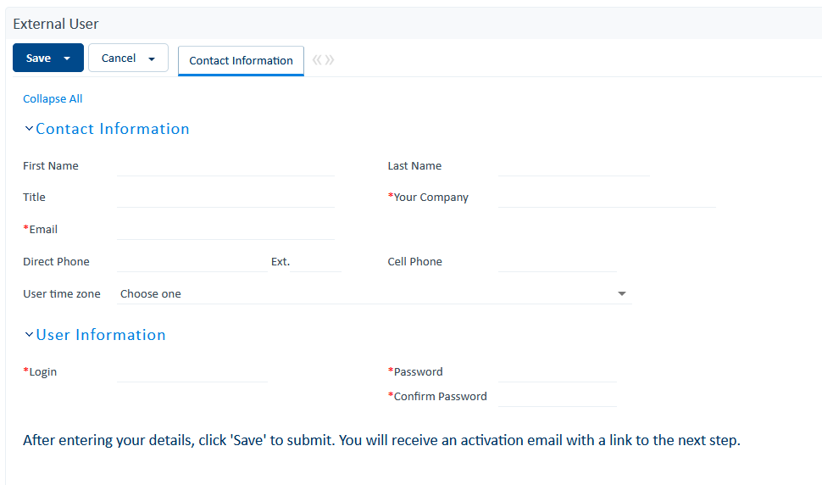
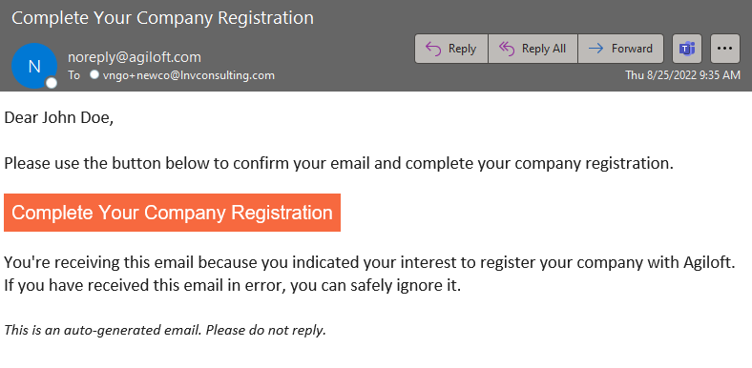
How to register as a vendor
Link to Kids Hope Alliance (Agiloft) Self Registration Page: KHA Vendor Self Registration
B
The system will send the company registration link to the email provide. Please make sure to provide the correct email.
A
Fill out all the required fields (red asterisk) and click Save.

Slide 4
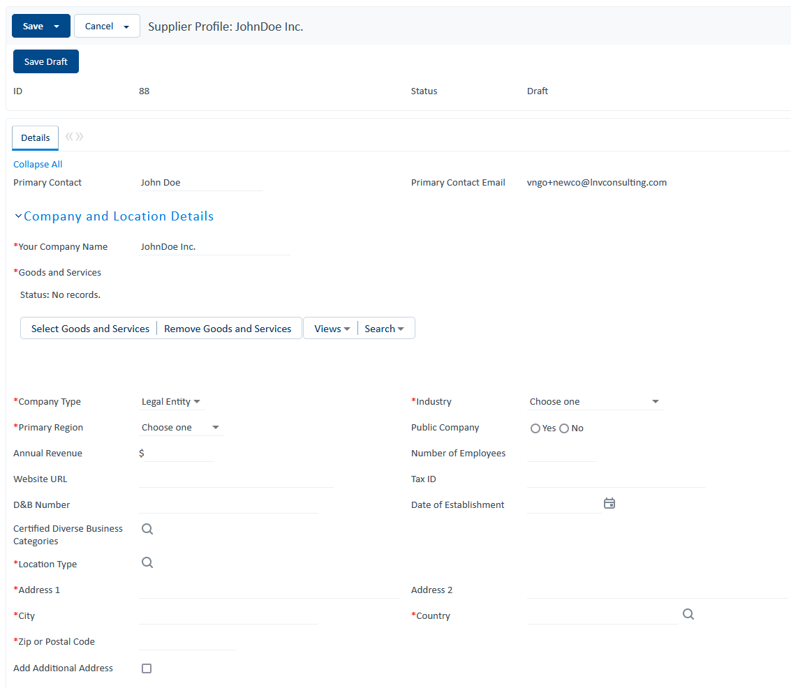
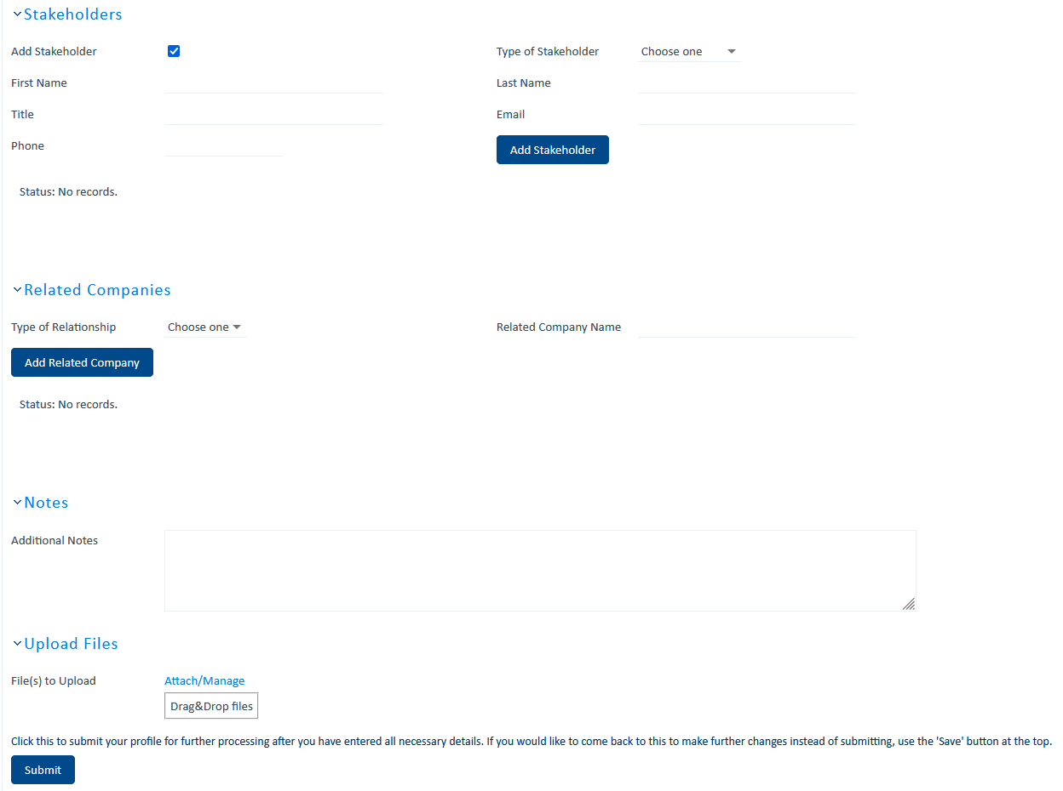
How to register as a vendor cont…
D
Provide additional information such as Stakeholders, Related Companies and upload any relevant documents. Click Submit when done.
C
Fill out all required fields within the Company and Location Details. For Good and Services, this allow you to select what type of good and services your company provides.

Slide 5
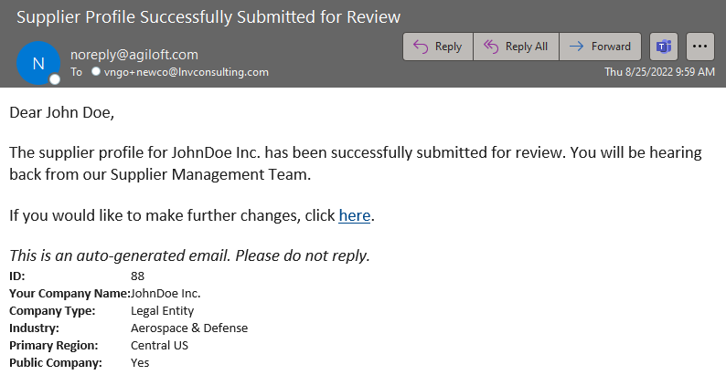
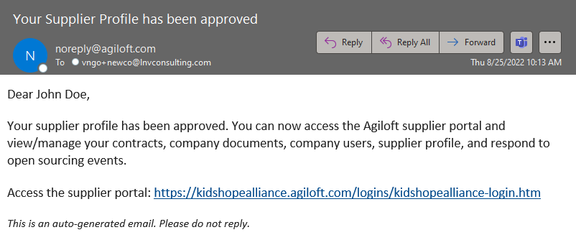
How to register as a vendor cont…
E
After Submitting you will receive the following email stating that your supplier profile is under review.
Once approved, you’ll receive the following email and now you can log in to the Supplier Portal.
G

Slide 6
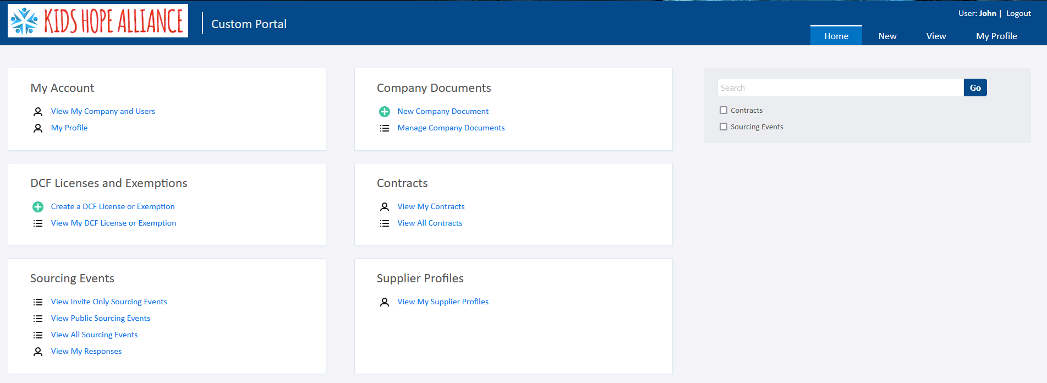
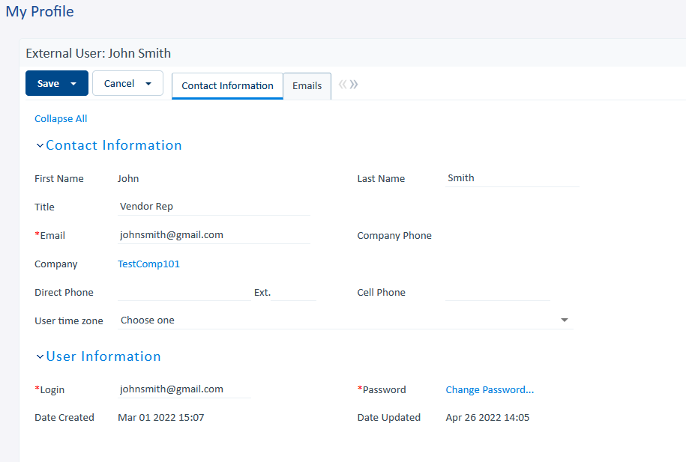
How to view vendor profile
Link to Kids Hope Alliance (Agiloft) Portal:
https://kidshopealliance.agiloft.com/logins/kidshopealliance-login.htm
B
Click “My Profile” to view your profile. From here you can update your contact information and even change your password.
A
Click “View My Company and Users” to view the company’s profile.

Slide 7
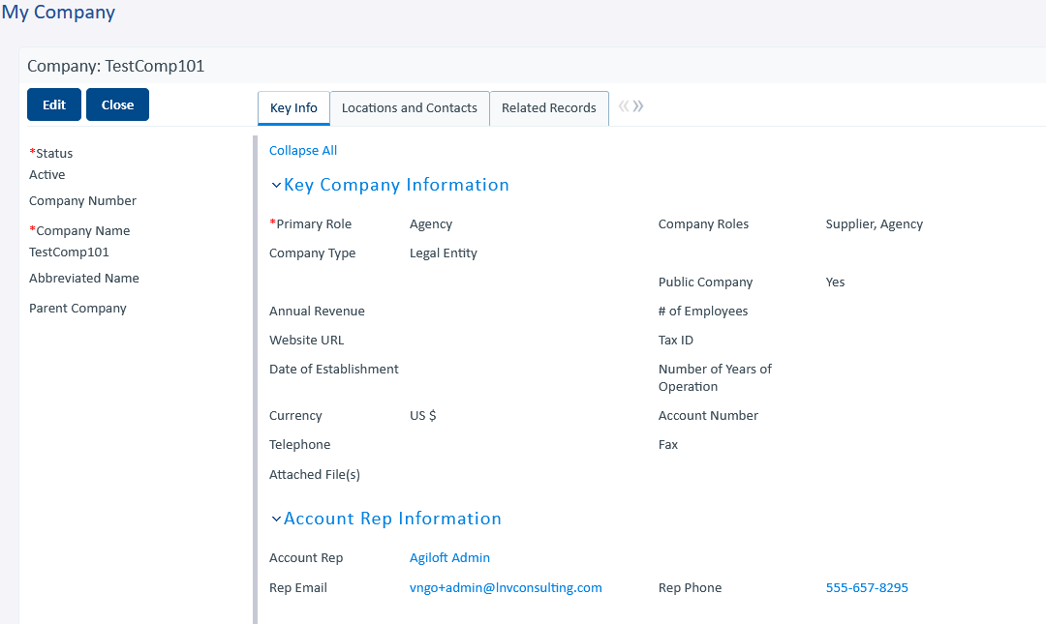
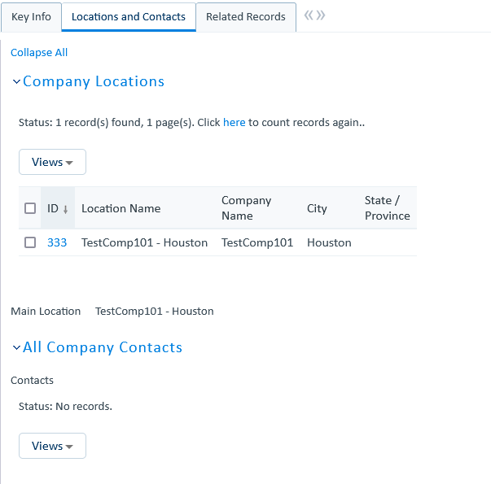
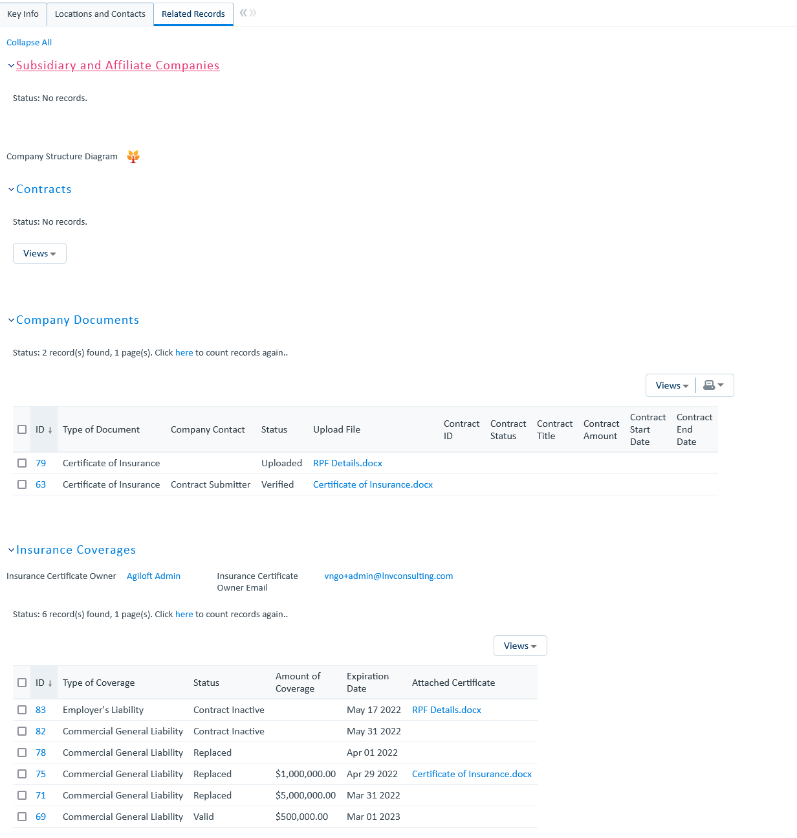
How to view vendor profile cont…
Use the tabs (Key Info, Locations and Contacts, and Related Records) to view other details about the company.
Key Info: Key attributes about the company
Location and Contacts: Locations and contact related to the company
Related Records: Related contracts, documents and insurance
D
C
Select Edit to edit the company profile. Note: only the locations can be edited and new locations can be added only.

Slide 8
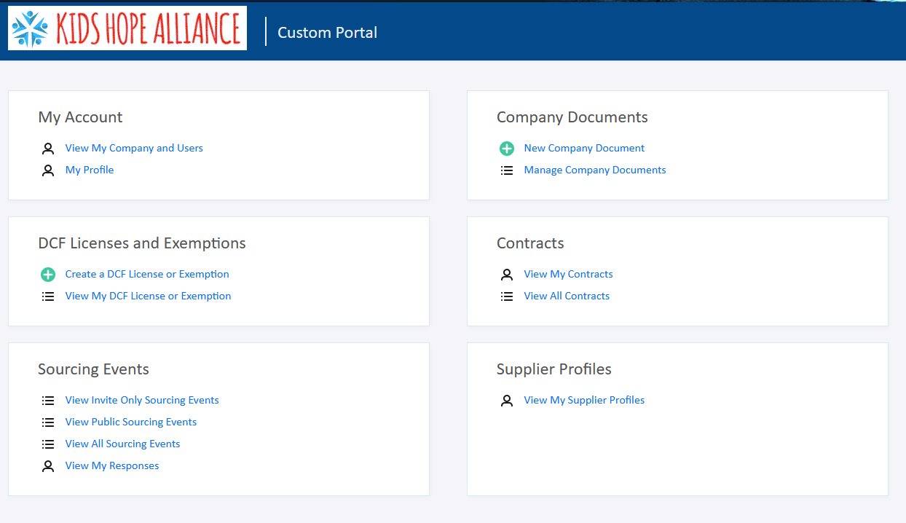
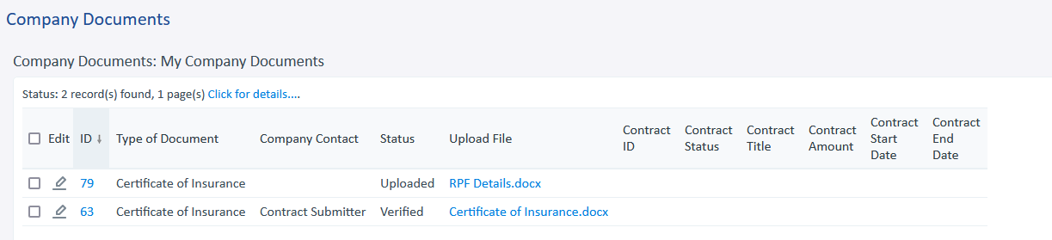
How to upload a Certificate of Insurance
Select New Company Document to upload new documents such as:
Budget
Letter of Intent
Scope
W9
Certificate of Insurance
A
B
Select Manage Company Documents to view all documents uploaded to the company profile. Note: you will only be able to edit documents you uploaded.

Slide 9
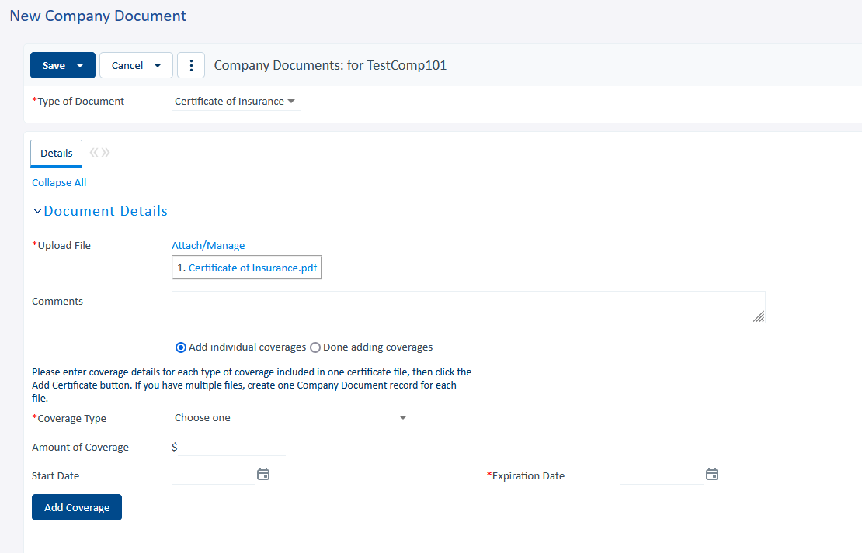
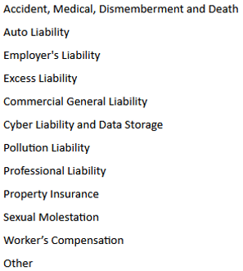
How to upload a Certificate of Insurance cont…
C
Type of Document, select Certificate of Insurance
E
Select Add Individual Coverage
Coverage Types
D
Drag and Drop the copy of your Certificate of Insurance here to attach the document.
F
Select the coverage type, provide coverage amount, start and expiration date for each coverage and hit Add Coverage.
G
Finally, click Save to save the Certificate of Insurance.

Slide 10
How to upload a DCF or Exemption License
A
Select Create a DCF License of Exemption to upload the documents
B
Select View My DCF License or Exemption to view and/or edit existing DCF License or Exemption that you have created.

Slide 11
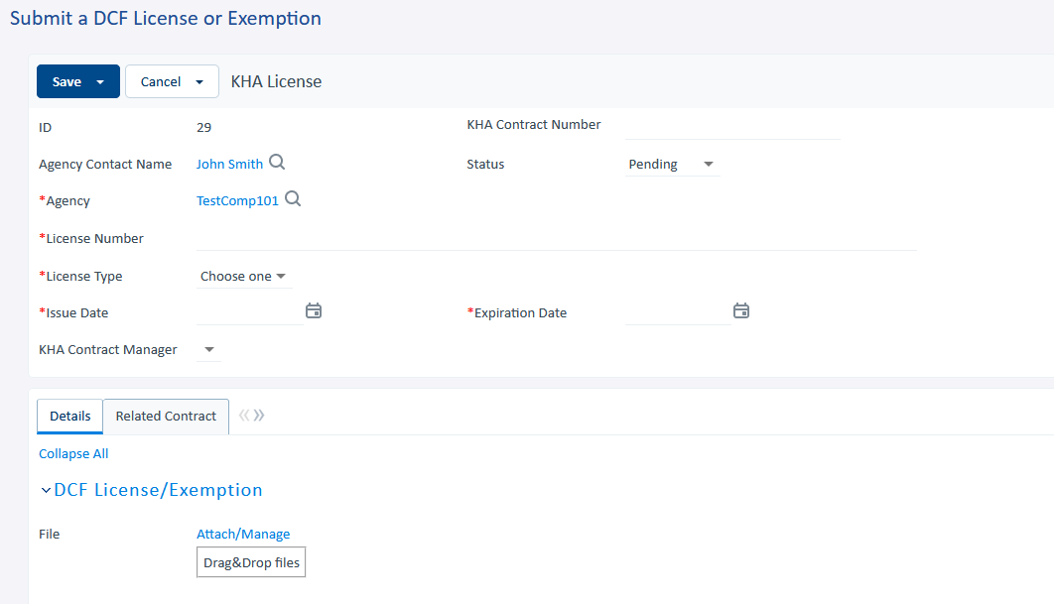
How to upload a DCF or Exemption License cont…
C
Important: You must provide the KHA Contract Number. This is how the DCF/Exemption will be associated to the contract and the site locations.
E
Provide the required fields such as:
License Number, License Type, Issue Date and Expiration Date.
License Type:
DCF License
Exemption
N/A
D
Agency Contact Name and Agency will be pre-populated based on the person creating the record.
F
Drag and Drop the DCF or Exemption file here to upload the file.
G
Finally, click Save. Once the record is saved, the KHA Contract Manager will associate this to the appropriate Contract and Site Location(s).

Slide 12
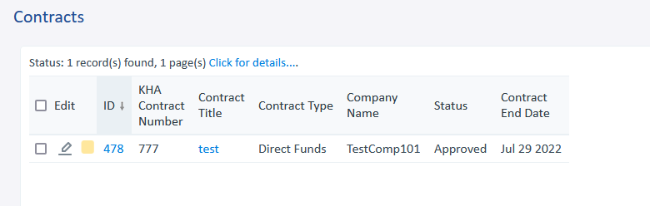
How to view related contracts
A
Select View My Contracts to view contracts you have created/submitted. This will be empty as you don’t have permission to create new contracts.
B
Select View All Contracts will display all contract submitted for the associated company/vendor/agency. Note: You will only be able to view.

Slide 13
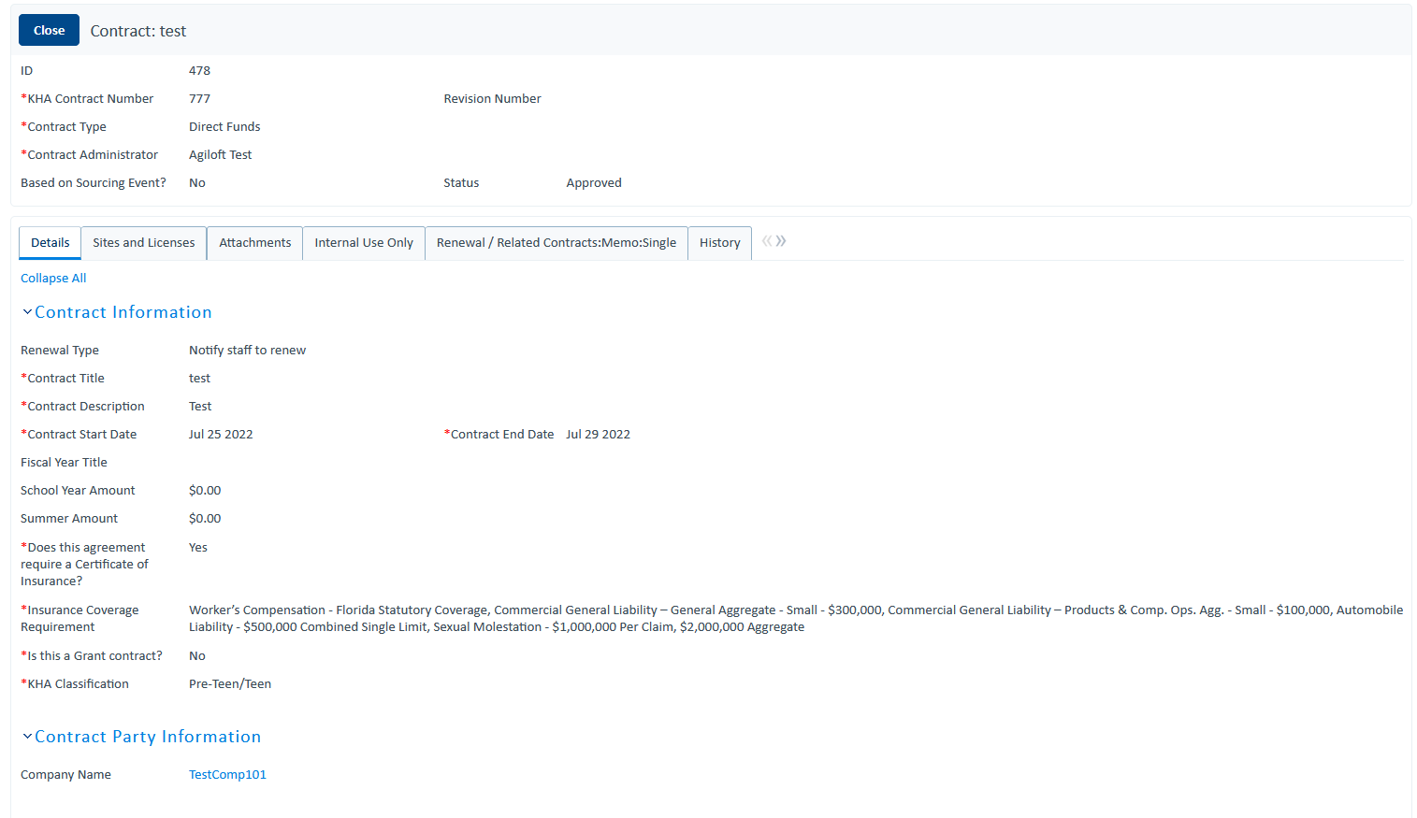
How to view related contracts cont…
C
Select the ID to view the contract
D
Use the tab to navigate through the different sections of the contract. On the Attachment tab, you’ll be able to upload Company Documents (e.g. Certificate of Insurance).

Slide 14
Q&A

