Slide 1
Early Literacy: KHA-Mayor’s Book Club
RFP Non-Construction 16576-25
Pre bid Conference
DATE: 4/2/25

Slide 2
SPEAKER INTRODUCTIONS
Olive Wallace-Cohen
Purchasing Analyst, Procurement Division
owcohen@coj.net
904-255-8816
JSEB and Ombudsman Designate
Kenneth Darity
Chief Administrative Officer, KHA

Slide 3

PRESENTATION FORMAT
How – Navigate the portal
  Access the application
  Preview requirement questionnaire
Where – Find it
  Cover Select Sections
  Documents/Forms
What – Important to know
  Specific RFP requirements
  Minimum contractor requirements
  Other important general info

Slide 4
DELIVERY AND CLOSING DATE
Response Delivery Location:
  1 Cloud System – Supplier Portal
  Must register as a supplier
  https://www.jacksonville.gov/departments/finance/procurement/supplier-portal
Bid Closing Date 4/22/25 @ 4:00 PM

Slide 5
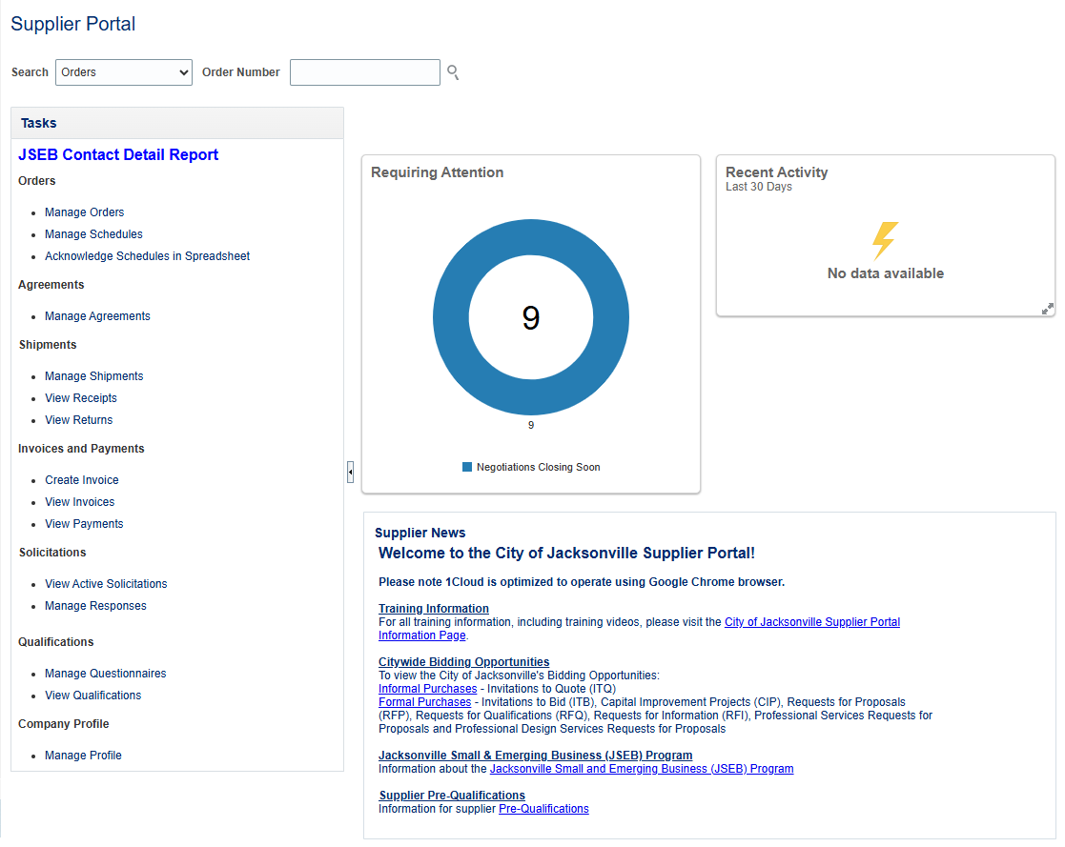
SUPPLIER PORTAL - Search
Search - Solicitations
Solicitation Number - 16576-25

Slide 6
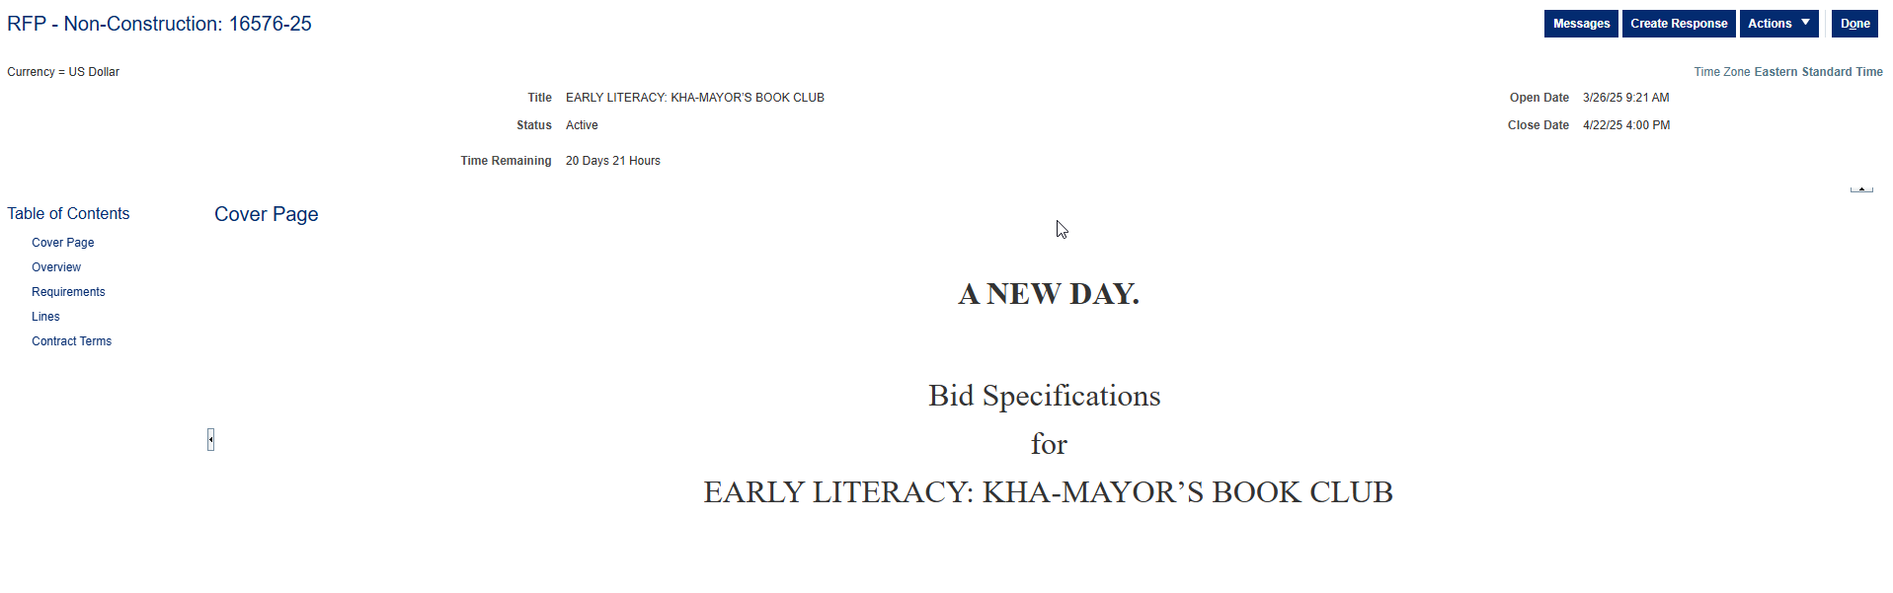
SUPPLIER PORTAL – Table of Contents

Slide 7
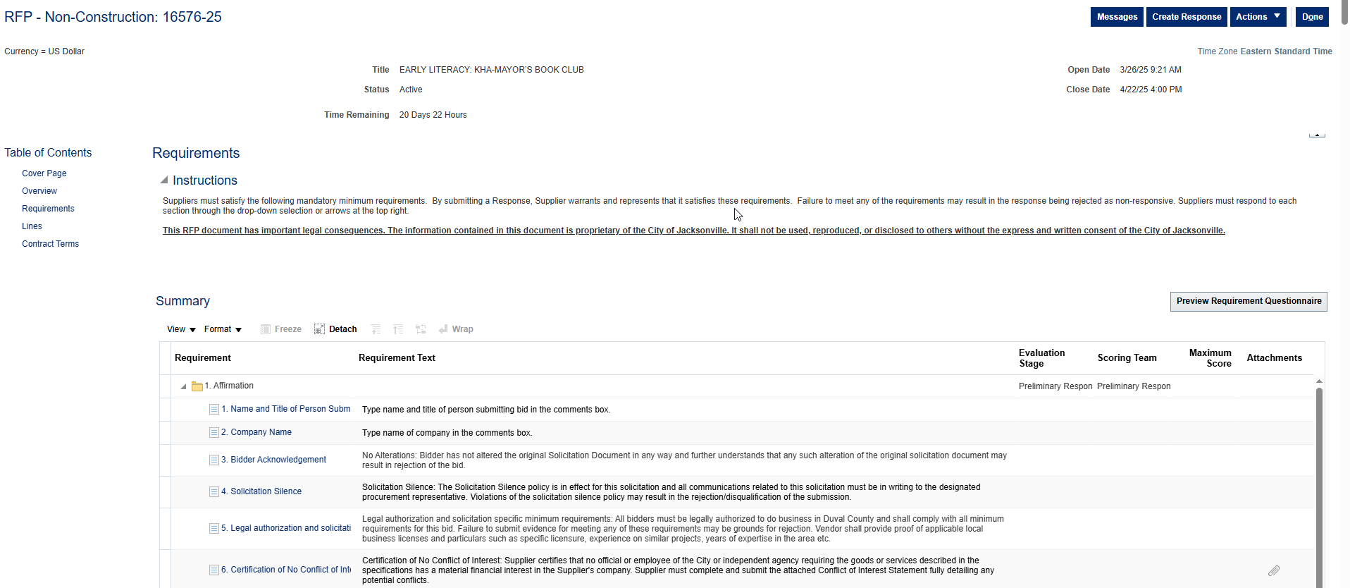
SUPPLIER PORTAL - Requirements

Slide 8
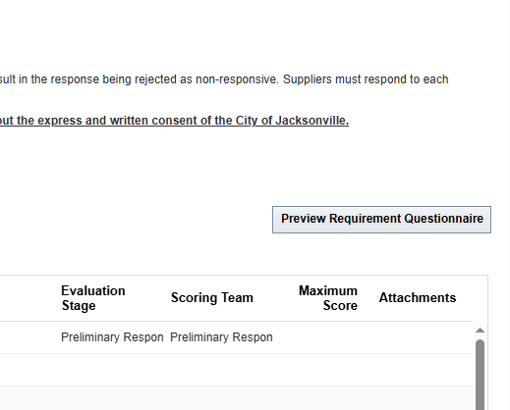
SECTION 1 - Affirmation
Click on Preview Requirement Questionnaire
(1) Name and Title
(2) Company Name
(3) No Alterations - acknowledges not altered Solicitation Document
(4) Solicitation Silence - all communications must be in writing
(5) Legal authorization - authorized to do business in Duval County
(6) No conflict of interest
(7) Equal Business Opportunity – JSEB
(8) Electronic Signature
*Must complete section to move on

Slide 9
SECTION 2 - General Requirements
$500,000 award amount
Target Population: Young children in Duval County from birth to age 4
Distribute monthly books and quarterly community outreach events
Provide proof of applicable local business license if located within Duval County.
Must be a tax-exempt organization under Section 501(c)(3) of the Internal Revenue Code.

Slide 10
SECTION 4 – RFP Requirements
3. Minimum Requirements for Contractors:
Registered as a nonprofit entity in State of Florida
Prior to June 1, 2022
“Active” status FL Department of State’s Sunbiz site (https://dos.myflorida.com/sunbiz/)
Must have operated a book club program for at least two (2) years
Served at least 1,000 participants within the past five years

Slide 11
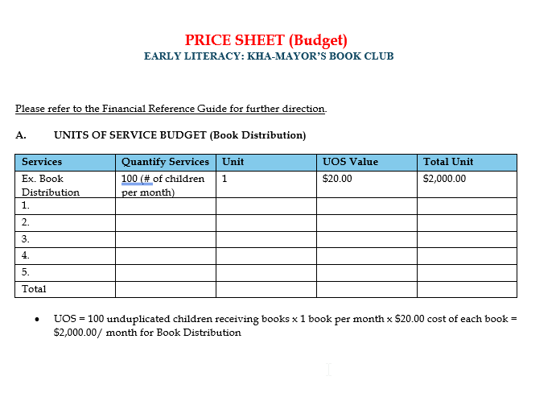
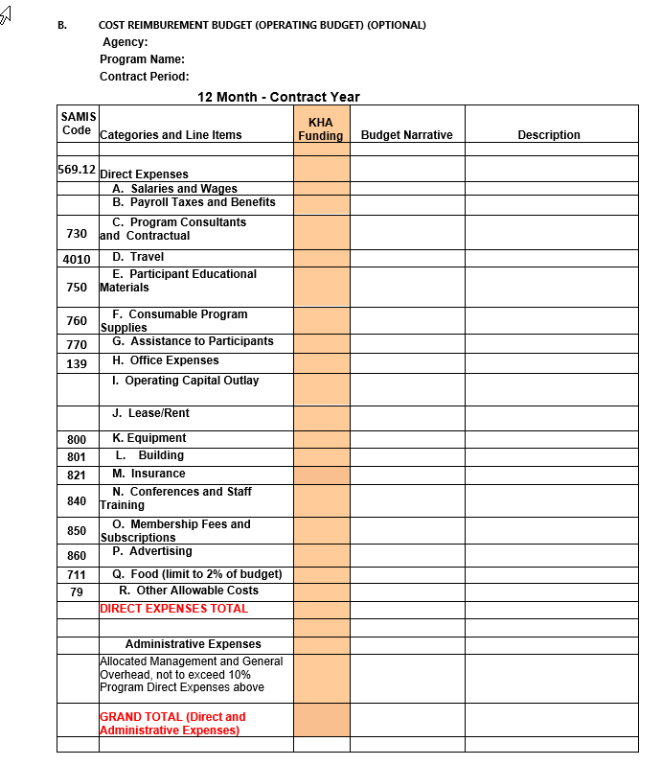
SECTION 9 – Price Sheet

Slide 12
SECTION 12 – Evaluation Matrix
Agency Background – (max 25 pts)
Implementation Plan – (max 15 pts)
Partnerships/Collaboration – (max 15 pts)
Evaluation Plan – (max 20 pts)
Budget: See Price Sheet – (max 10 pts)
Pay close attention to scoring matrix – evaluation criteria details
Contractors must score a minimum of 80% of points overall to be considered for funding.
85 Total Possible Points

Slide 13

OTHER IMPORTANT REMINDERS
Section 13 – Evaluation Criteria/Response Stage
Initial Term: June 1, 2025 – May 31, 2026
Buyer has the option for (4) one-year renewals
Deadline to submit questions 4/11/25 @ 5:00 PM
An addendum will be sent to all respondents
Pre-bid recording available https://www.kidshopealliance.org/RFP/RFP9.aspx
Complete survey – browser and email

Slide 14


