Slide 1

KHA-Mayor's Youth at Work Partnership Internship Program
PRE-BID CONFERENCE: RFP-17438-26
DATE: January 6, 2026
Time: 10:30 AM

Slide 2
SPEAKER INTRODUCTIONS
Olive Wallace-Cohen
Purchasing Analyst, Procurement Division
owcohen@coj.net
904-255-8816
JSEB - Office of Economic Development
Angie Dixon - Ombudsman City of Jacksonville
John Everett -Director of Workforce Development, KHA
RFP 17438-26

Slide 3
IMPORTANT REMINDERS
Webinar Format
Q&A Feature
Questions answered at end of presentation
Brief survey at end of the presentation
This Pre-Bid is Mandatory and submission from vendors who did not attend this Prebid will not be accepted.
This Bid is designated JSEB Encouragement and is therefore open to all qualified Vendors.
If you are a JSEB Vendor or will be using a JSEB as a Sub-Contractors, please complete all the necessary forms.
Deadline for questions/queries is 01/13/2026 @ 5:00 pm
RFP 17438-26

Slide 4
DELIVERY AND CLOSING DATE
Response Delivery Location:
  1 Cloud System – Supplier Portal
  Must register as a supplier
  https://www.jacksonville.gov/departments/finance/procurement/supplier-portal
  All bids must be submitted in 1Cloud – Do not mail/ courier or email your bids
Bid Closing Date 01/23/2026 @ 4:00 PM Late bids will not be accepted!
  Vendors can make revision to their bids up to the time of submission
  All addendums must be acknowledgement – acknowledgement notifications is usually emailed through 1Cloud and vendors should continue to check 1Cloud especially if they submitted a proposal early.
  Please ensure that attachments are downloaded, completed and re-uploaded properly

Slide 5

PRESENTATION FORMAT
How – Navigate the portal
  Access the application
  Preview requirement questionnaire
Where – Find it
  Cover Select Sections
  Documents/Forms
What – Important to know
  Specific RFP requirements
  Minimum contractor requirements
  Other important general info

Slide 6
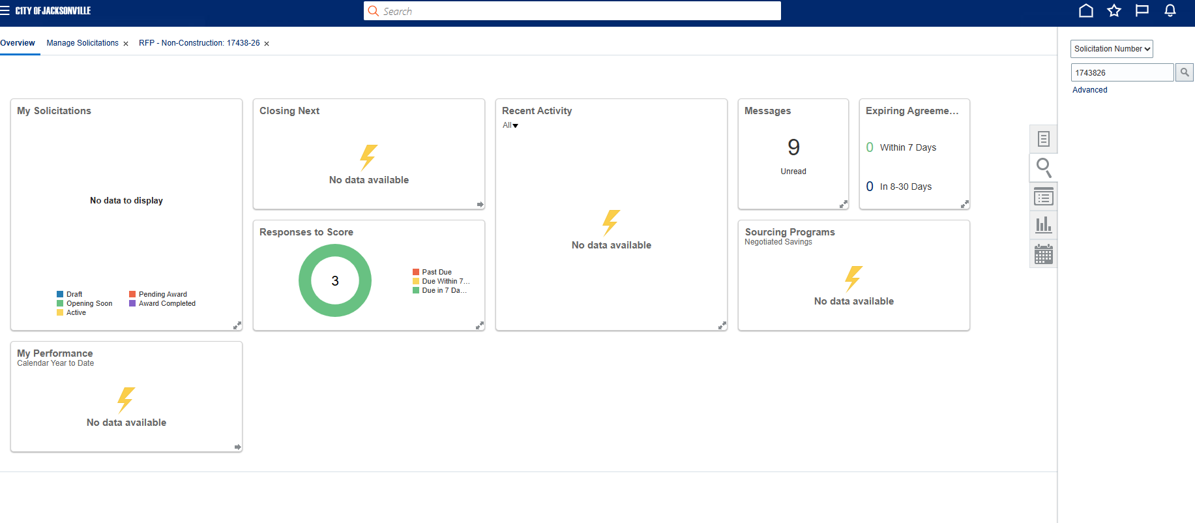
SUPPLIER PORTAL - Search

Slide 7
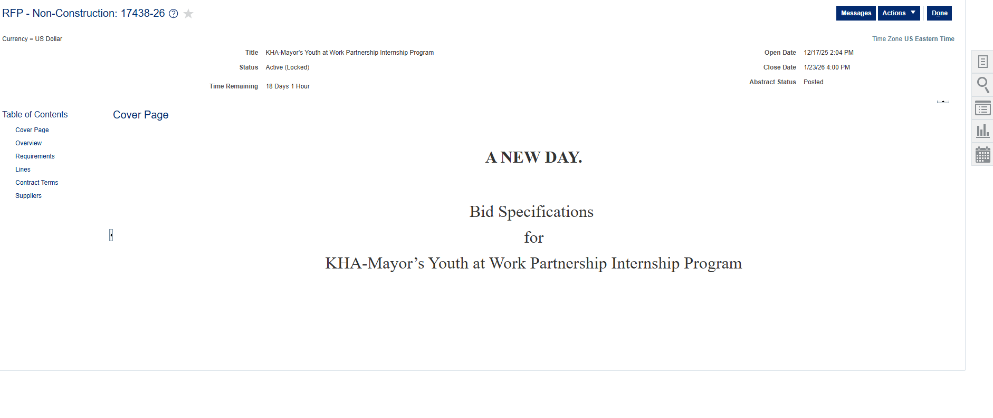
SUPPLIER PORTAL – Table of Contents

Slide 8
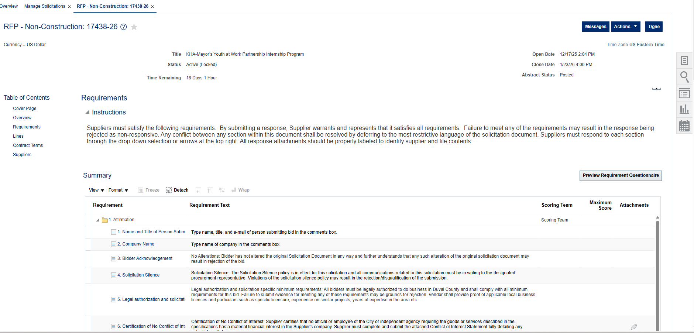
SUPPLIER PORTAL - Requirements

Slide 9
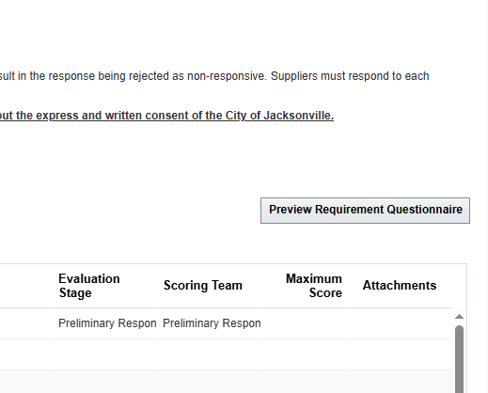
SECTION 2.1 - Affirmation
Click on Preview Requirement Questionnaire
(1) Name and Title
(2) Company Name
(3) Bidder Acknowledgement - acknowledges not altered solicitation document
(4) Solicitation Silence - all communications must be in writing
(5) Legal authorization - authorized to do business in Duval County
(6) Certificate No conflict of interest
(7) Equal Business Opportunity
(8) Electronic Signature
*Must complete section to move on

Slide 10
SECTION 2 - General Requirements
Scope of Work/Program Design Requirements
Minimum Supplier Qualifications
Response Format for RFP
Federal Funds do not apply to this RFP
RFP 17438-26

Slide 11
Scope of Service/Program Design Requirements
The Kids Hope Alliance (KHA) is seeking an appropriately qualified contractor to implement the service option in the Mayor’s Youth at Work Partnership (MYAWP) Program. This service option is part of a larger roadmap designed to build an integrated system that transitions Jacksonville youth from high school to high-wage employment. KHA anticipates funding a model(s) that will strengthen Jacksonville’s workforce development system and help young people gain the support, educational credentials, and skills needed to succeed in todays and the future economy.
The overarching goal of the MYAWP is to provide a minimum of 500 youth with a set of work-related experiences that prepare them to succeed in employment. MYAWP will help participants achieve the following objectives:
Develop social skills including communication, critical thinking, decision-making, problem solving, and self-management.
Learn work norms and culture.
Understand career pathways and decision points, including the linkages among educational attainment, relevant experience, demonstrable skills, and career advancement.
Build professional networks and develop an entrepreneurial mindset.
Learn to manage money (e.g., budgeting, opening a bank account).
RFP 17438-26

Slide 12
SECTION 2.4 – RFP Requirements
3. Minimum Requirements for Contractors:
Registered as a nonprofit entity in State of Florida
Prior to September 1, 2023
“Active” status FL Department of State’s Sunbiz site (https://dos.myflorida.com/sunbiz/)
Contractor (not just individuals employed by Contractor) must have operated a program for at least one year that has served at least 50 youth that were touched by the juvenile justice system. Operation must have occurred during 2024, 2023, 2022.

Slide 13
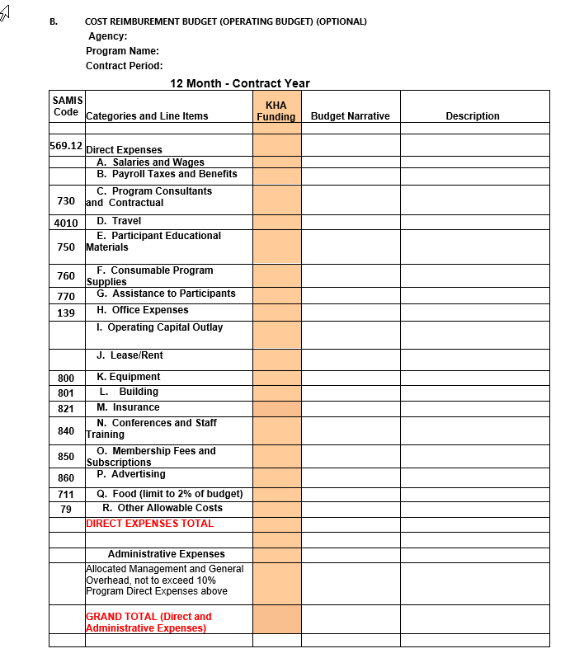
SECTION 2.6 – Budget/ Price Sheet/Advance

Slide 14
SECTION 2.9 – Evaluation Matrix
Contractor Detail – (max 10 pts)
Organizational Capability – (max 70 pts)
Proposed Staff Information – (max 40 pts)
Program Design – (max 180 pts)
Budget: See Price Sheet – (max 15 pts)
Performance Measures and Data Management (max 30 pts)
Pay close attention to scoring matrix – evaluation criteria details
Contractors must score a minimum of 80% of points overall to be considered for funding.
305 Total Possible Points

Slide 15

OTHER IMPORTANT REMINDERS
Section 2.11 – Evaluation Criteria/Preliminary Response Stage
Initial Term: June 1st, 2026 – May 31, 2027.
Second year will begin June 1, 2027 –May 31,2028.
Buyer has the option for (3) one-year renewals
Deadline to submit questions 1/13/2025 @ 5:00 PM
Any addendum will be sent to all respondents
Pre-bid recording available on CollaborNation

Slide 16


