Slide 1

Vendor Registration v1.0
Agiloft – Kids Hope Alliance

Slide 2

What is Agiloft?
  A cloud-based Contract Lifecycle Management solution helps to automate workflows associated with initiating, executing and monitoring contractual agreements and supporting documentation.
  Agiloft as implemented for the Kids Hope Alliance integrates DocuSign for e-signatures.
Why do I need to register in Agiloft?
  All Kids Hope Alliance contracts are now created, processed and maintained within the Agiloft system.
  All future KHA Request for Proposal (RFP) initiatives will originate from and be scored within Agiloft. However, the current City Procurement requirements have not changed in terms of submitting the RFP application in person.
Will my organization still need to be registered in the City’s 1Cloud Supplier Portal?
  Yes, all vendors/suppliers MUST be registered in 1Cloud. Agiloft is a contract management system and DOES NOT replace the City’s supplier portal known as 1Cloud.

Slide 3
Vendor Self Registration Steps
Enter your Organizational, name and contact information into the Agiloft new External User page.
Receive a verification email with link back to the Agiloft system.
Complete your Organizational profile page from email link.
Logout and bookmark the Agiloft portal.
Receive the confirmation email that your organization is now active (3 hours).
Confirm that you can successfully login to your Agiloft account.
Stand by for next steps from KHA.

Slide 4
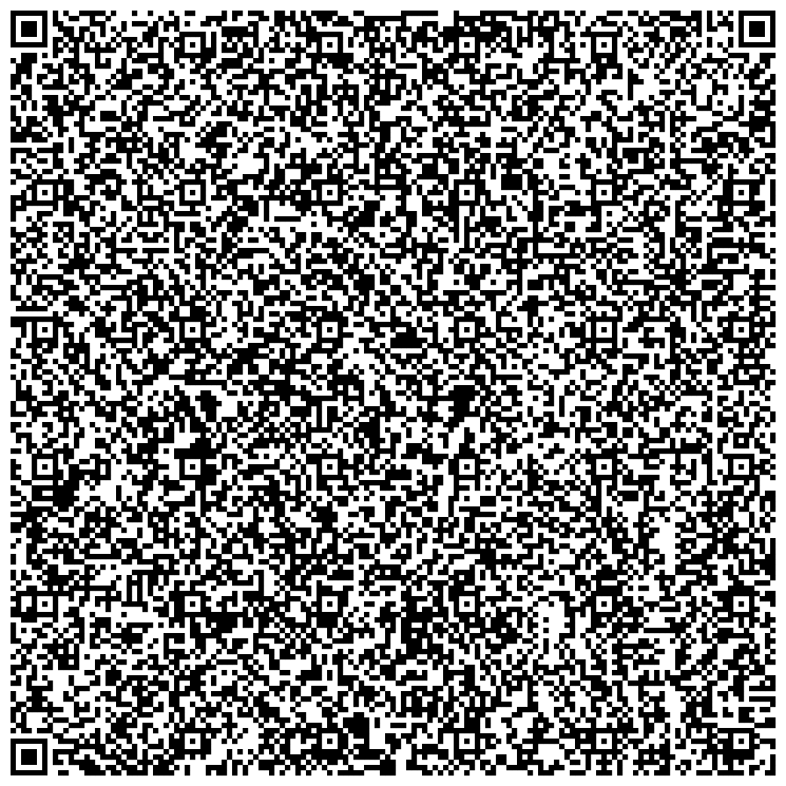
Agiloft
Vendor Self Registration
Register your organization here. Only 1 Agiloft user account is needed to utilize Agiloft.
  YouTube Video – How to register in Agiloft: https://youtu.be/9R223bLfFfo
Agiloft Resources on the KHA website:
https://www.kidshopealliance.org/Providers/Provider-Resources.aspx

Slide 5
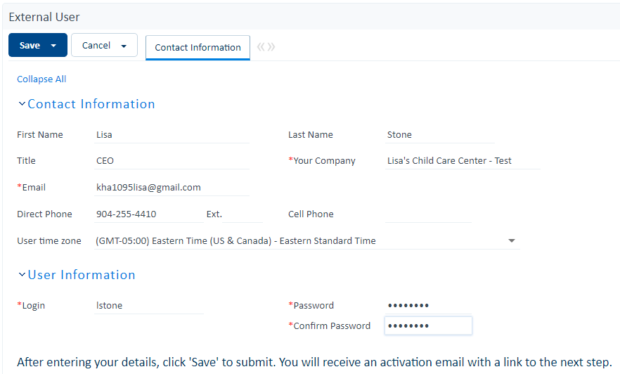
System Required Fields
Necessary Fields
Legal Name as found on Sunbiz.

Slide 6
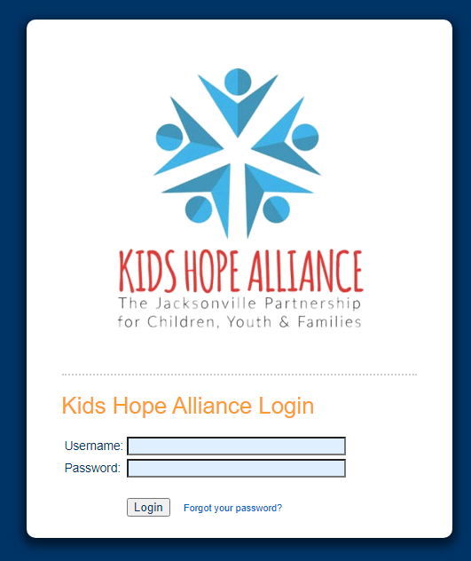
Upon saving the External User screen you should see this portal after automatically being logged out of Agiloft. Bookmark this URL on your browser for future reference and expect an email from kha_contracts@coj.net.
https://kidshopealliance.agiloft.com/logins/kidshopealliance-login.htm

Slide 7
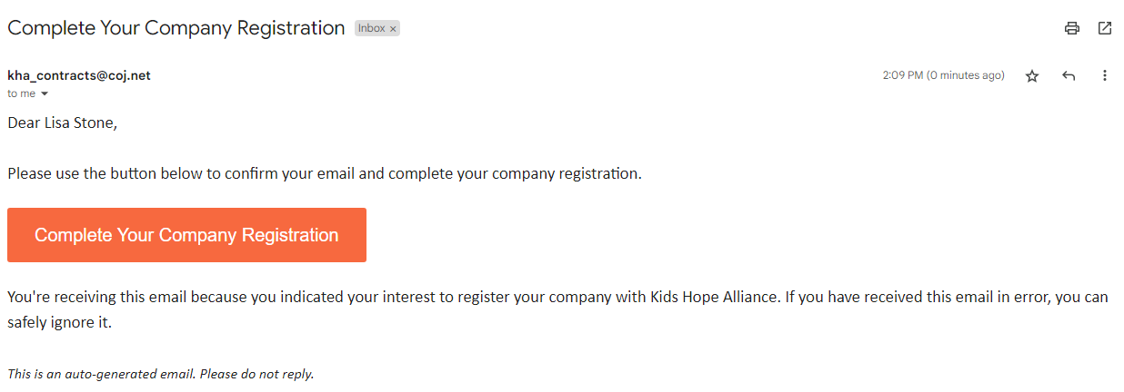
E-mail received after entering the External User information.
Agiloft system email will be sent from this address.
Click here to return to Agiloft.

Slide 8
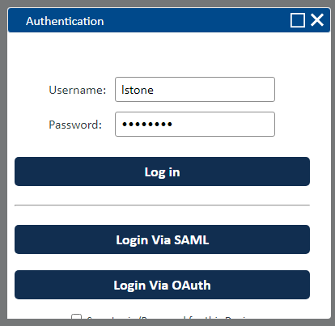
Upon clicking the ‘Complete Your Company Registration’ button in the email, you will be directed to this portal.

Slide 9
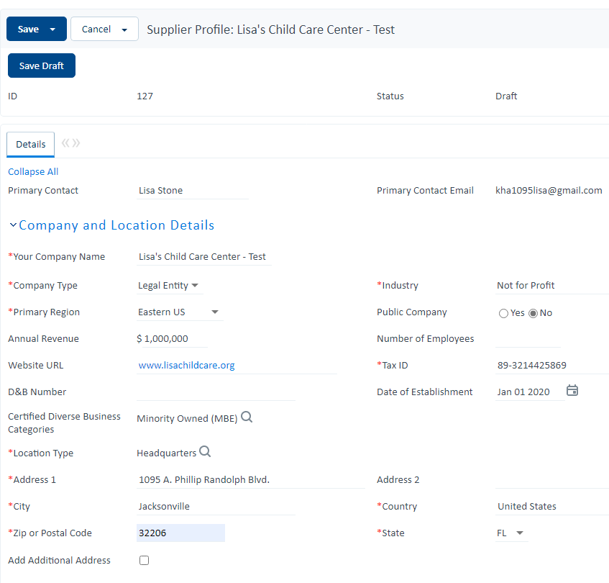
This Agiloft ‘required’ field is not a critical KHA field. If you don’t see something you believe matches your organization well, use ‘Other’.

Slide 10
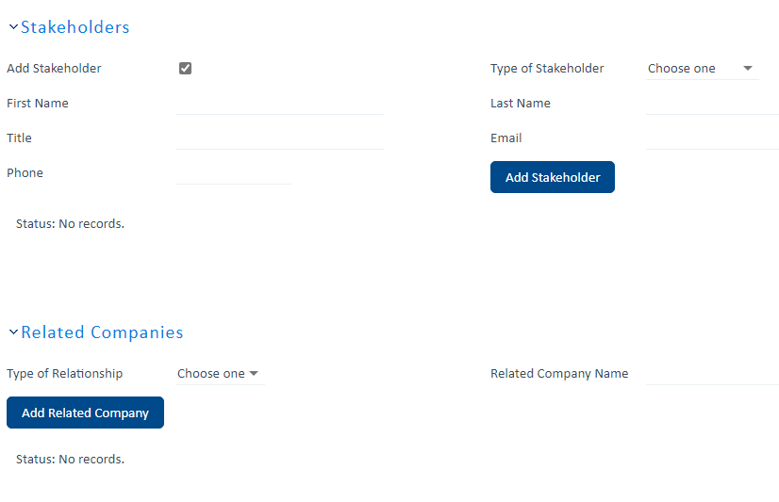

Slide 11
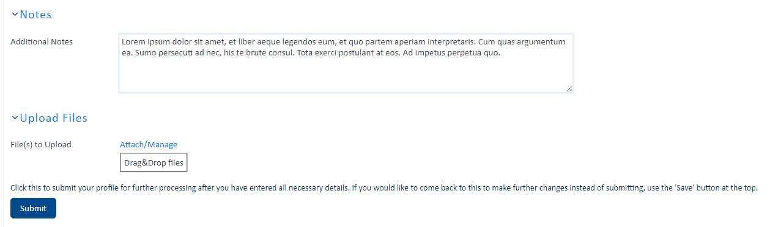
Ensure, you click submit at the bottom of the screen. If you exit without clicking submit, you must return and complete the process by clicking this button.

Slide 12
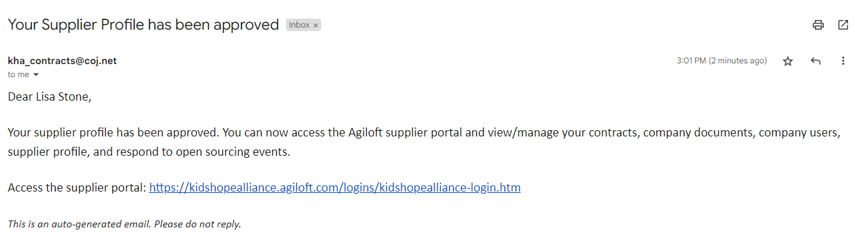

Slide 13
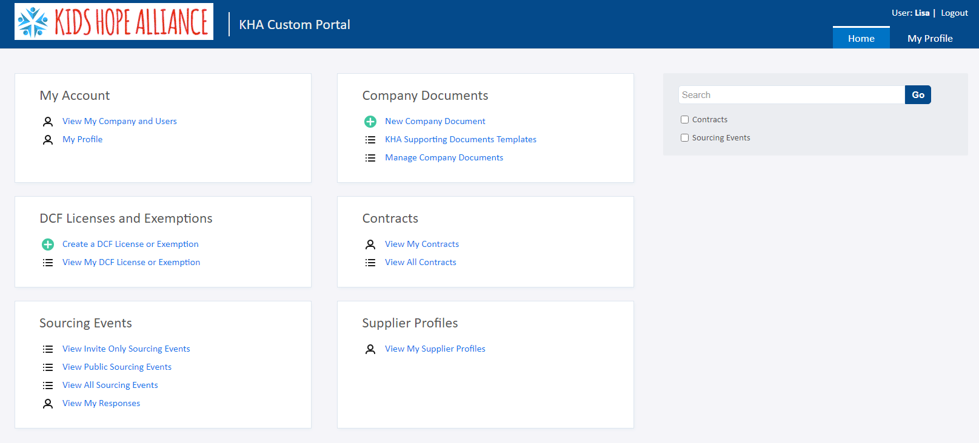

Slide 14
Agiloft Technical Assistance
For questions related to Vendor Registration in Agiloft, please contact us as shown below:
Email: agiloft@coj.net
Phone: 255-4410
All providers funded by KHA or who would like to be funded by KHA must be registered in Agiloft.

