Slide 1
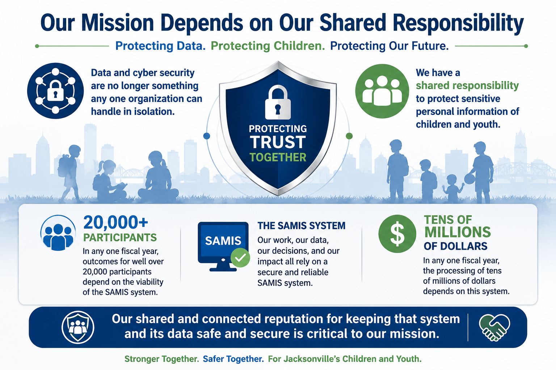

Slide 2
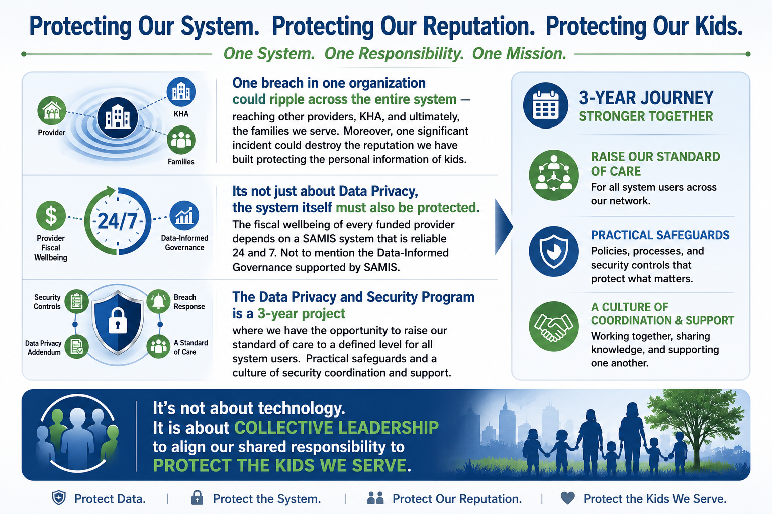

Slide 3
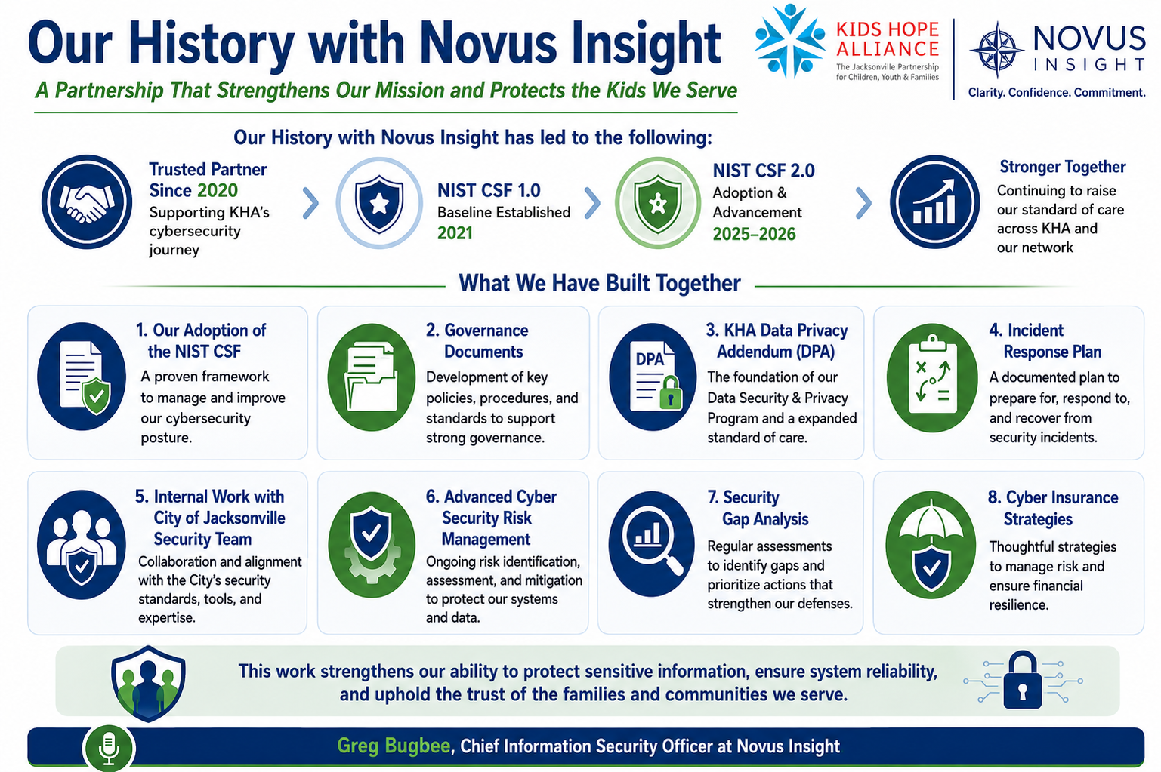

Slide 4

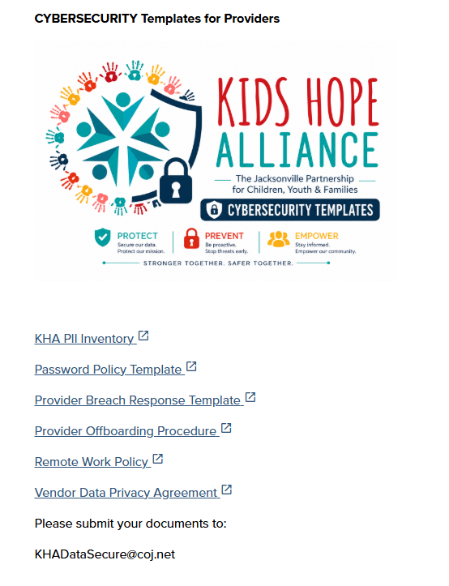
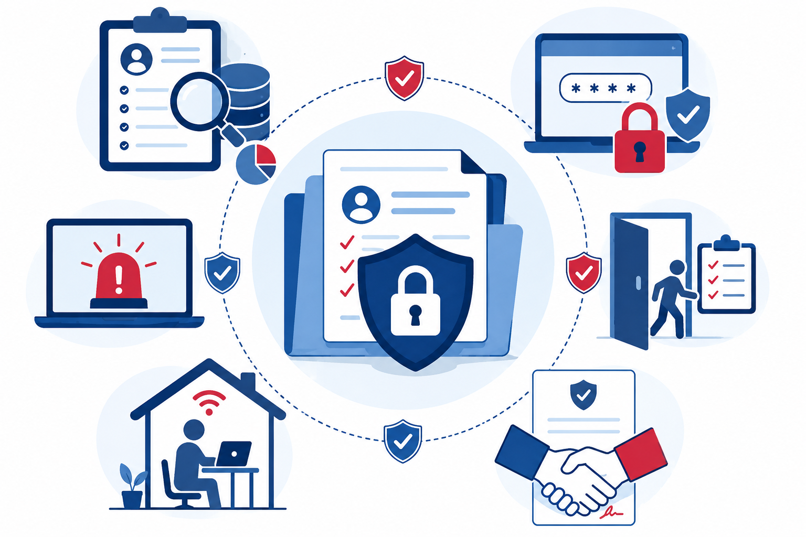
https://www.kidshopealliance.org/technical-support
KHADataSecure@coj.net
Report Security Events/Submit Security Documents

Slide 5
PROTECTING
THE KIDS WE SERVE
Data Security & Privacy Program | Kids Hope Alliance
When families share their information with our programs, they trust us to protect it.
This training is about honoring that trust, together.
kidshopealliance.org | KHADataSecure@coj.net | 904-255-4410

Slide 6








TODAY'S SESSION
What We'll Cover
Why this matters: for kids, families, and our network
How we're all connected, and what that means for risk
The Addendum: what changed and what it means in plain language
The 13 controls: practical steps, most of them free
When something goes wrong: how to respond
The three-year rollout: what's expected and when
The resources we've built for you, ready to use
Your first steps, starting today

Slide 7
OVER TO YOU
"In a few words, what does your program do for the young people you serve?"

Slide 8
SECTION 1
Why This
Matters
Families trust us with their most sensitive information.
That trust is the foundation of everything we do.

Slide 9
WHY THIS MATTERS
Think About the Family on the Other End
Imagine a single parent who enrolled their child in one of your after-school programs. They trusted you with their home address, their child's school, their health information. Now imagine that data ends up in the wrong hands. A laptop was stolen, or an old staff account was left open, or someone responded to a convincing email they shouldn't have.
This isn't about regulatory compliance for its own sake. It's about keeping our promise to the families who walk through our doors.
The Family
Your Organization
The Network
Their information is exposed. Their trust in your program, and in the system that referred them, is damaged. Some families may not come back.
You face notification costs, potential legal liability under Florida law, and a reputational hit in a small community where word travels fast.
KHA's agreements with DCPS and the City depend on every provider protecting data. One breach can trigger scrutiny of the entire system, putting every provider's funding relationships at risk.

Slide 10
WHY THIS MATTERS
We Are All Connected. That's the Point and the Risk
KHA funds 150+ provider organizations delivering services to youth and families across Duval County. That network (academics, enrichment, nutrition, mental health, juvenile justice) is a system of care built over years of partnership.
But connected systems share risk. When an attacker compromises one provider's email, they use that trusted address to target other providers and KHA itself. A breach at your organization doesn't stay at your organization.
1
A staff member's email is compromised at Provider A
2
Attacker sends convincing messages from that trusted address to Provider B and KHA
3
If Provider B clicks, they're compromised too, and the attacker now has data from two programs
4
The attacker now targets KHA directly using the trusted provider relationship. A successful attack on KHA could disrupt funding and services for youth across the entire county
This addendum exists because protecting participant data is a shared responsibility across the entire network, not something any one organization can do in isolation.

Slide 11
WHY THIS MATTERS
This Is a Leadership Responsibility
If your organization has an IT person, that's great. But data security is not an IT function. It's an organizational commitment. The most common breaches don't happen because of technical failures. They happen because of human decisions: a shared password, an account that wasn't turned off, a laptop left in a car.
Most of the 13 controls in this program are decisions, not technology. They require leadership, someone who says "this is how we do things here."
IT'S NOT ABOUT...
IT'S ABOUT...
✕ Buying expensive software
✓ Deciding how your organization handles data
✕ Hiring a cybersecurity team
✓ Building habits that protect families
✕ Passing a technical audit
✓ Knowing what to do when something goes wrong
✕ Having a perfect score on Day 1
✓ Making honest progress and documenting it

Slide 12
SECTION 2
The Addendum
What changed, what it covers, and what it means for your programs.

Slide 13
THE ADDENDUM
Three Things the Addendum Establishes
A
A Standard of Care
Keep participant information confidential. Use it only for program purposes. Make sure anyone who touches that data (staff, volunteers, subcontractors) is bound to the same standard in writing.
B
13 Required Security Controls
Put practical safeguards in place. These aren't aspirational. They're required. We'll walk through each one and show you they're mostly free and straightforward.
C
Breach Response: The 48-Hour Rule
If something goes wrong, tell KHA within 48 hours. We'll walk through exactly what to report and who to call. The goal is early coordination, not punishment.
The Addendum establishes that KHA has the right and obligation to protect participant data collected across its funded programs. Your organization is the day-to-day steward of that data. That means you control access, secure it, and use it to deliver services. It also means you cannot disclose it to outside parties without KHA's written approval.

Slide 14
THE ADDENDUM
PII: The Information You're Protecting
PII is any information that can identify a specific person, alone or combined with other data. In your programs, you almost certainly have more of it than you think.
You Definitely Have This
You Probably Have This
You Might Have This
▸ Participant names
▸ School records (FERPA-protected)
▸ Social Security numbers
▸ Dates of birth
▸ Health or insurance info (HIPAA)
▸ Student ID numbers
▸ Home addresses
▸ Emergency contacts
▸ Financial account info
▸ Phone numbers & emails
▸ Attendance and progress notes
▸ Immigration status
▸ Program enrollment records
▸ Behavioral records
▸ Court or juvenile justice records

Slide 15
SECTION 3
The 13 Controls
Practical steps, not expensive technology.
Most are free. All are within reach.

Slide 16
THE 13 CONTROLS
Two Tiers: Start with the Six That Matter Most
HIGH RISK: 6 Controls
STANDARD: 7 Controls
These are the front door, the deadbolt, and the alarm system. If these aren't in place, everything else is secondary.
Important and required, but often straightforward to implement. Many are just settings you turn on.
● M1 Name a Cybersecurity Point Person
● M4 Limit Who Can See Data
● M6 Strong Passwords & Change Defaults
● M2 Turn on MFA
● M7 Train Your Staff Annually
● M3 Know Where Your Data Lives
● M10 Separate Admin Accounts
● M5 No Shared Logins
● M11 Lock Out After Failed Logins
● M12 Keep Software Updated
● M8 Revoke Access When People Leave
● M13 Lock Cabinets, Secure Devices
● M9 Encrypt Your Devices

Slide 17
THE 13 CONTROLS: HIGH RISK
The Six That Prevent the Most Common Breaches
M1
Cybersecurity Point Person
Someone in your org owns this. It's probably your operations lead. They don't need to be technical. They need authority to act.
M2
MFA on Email & PII Systems
A second proof when logging in. This single step stops most account takeovers. If you do one thing after this training, do this.
M3
PII Inventory
A simple spreadsheet: what data, where is it, who can access it. You can't protect what you haven't mapped.
M5
Named Accounts Only
Each person logs in as themselves. Shared logins make it impossible to know who did what, and impossible to turn off access when someone leaves.
M8
Same-Day Offboarding
When someone leaves, their access ends that day. Not next week. Not when IT gets around to it. That day.
M9
Encrypt Devices
Turn on BitLocker or FileVault. A lost encrypted laptop is not a breach under Florida law. An unencrypted one is.

Slide 18
THE 13 CONTROLS: STANDARD
Seven More Steps, Most Are Just Settings You Turn On
M4
Least Privilege
Only the people who need data should see it. Review who has access every quarter. Remove access when roles change.
M6
Passwords & Defaults
12 characters minimum. Change every factory default on your router, apps, and devices. A passphrase like BlueBananaRiver!2026 is stronger than P@ssw0rd.
M7
Annual Training
Train all staff once a year on PII, phishing, and what to do in a breach. You're doing it right now. Keep it going.
M10
Admin Separation
If someone has admin privileges, they should have a separate login for admin work. Keeps the blast radius small if their daily account is compromised.
M11
Account Lockout
Lock accounts after 5 failed login attempts. This is a checkbox in most platforms.
M12
Patching
Turn on auto-updates. Check monthly for anything that slipped through. Outdated software is the unlocked window of cybersecurity.
M13
Physical Security
Lock your file cabinets. Don't leave laptops in cars. Post a remote work policy and have staff sign it.

Slide 19
SECTION 4
When Something
Goes Wrong
It's not about if. It's about how fast you respond.
Speed and honesty protect everyone.

Slide 20
WHEN SOMETHING GOES WRONG
The 48-Hour Rule: How to Respond
1
Contain It
Disconnect the affected system from the network. Don't turn it off. Just unplug it. Preserve evidence. Screenshot what you see.
2
Alert Your Cybersecurity Point Person
Your cybersecurity point person takes the lead. They coordinate everything from here.
3
Notify KHA: Within 48 Hours
Email KHA Data Systems KHADataSecure@coj.net (request read receipt). CC your Contract Manager. If email is compromised, call 904-255-4410. Include what happened and what data may be involved.
4
Call Your Insurance Carrier
If you have cyber insurance, notify your carrier per your policy. They can provide expert support.
5
Fix It and Document It
Change passwords. Patch the vulnerability. Document everything you did and when. Depending on the scope of the incident, KHA will coordinate with you on notifying affected families if needed.

Slide 21
WHEN SOMETHING GOES WRONG
Scenario: Someone Asks for Your Participant List
THE SITUATION
WHAT TO DO
Someone calls your front desk identifying themselves as a university researcher. They say they're conducting a public health study and ask for a list of your program participants and demographic information.
They sound professional. They have details about your program. A helpful staff member wants to cooperate.
1. Don't share anything, not even a count.
2. Ask them to put their request in writing.
3. Contact your KHA Contract Manager and Data Systems before responding.
4. KHA will help verify whether it's legitimate.
This is a real scam pattern. Fake research requests and fraudulent subpoenas are used to harvest participant data. Let KHA help you verify before you respond to anything.
5. Document the request: who, when, what they asked for.
6. Your Vendor Request Response template covers this.

Slide 22
OVER TO YOU
A caller says they are a researcher and asks for your participant list. What is your first move?
A Answer a few of their questions to be helpful.
B Share only a head count, nothing that identifies anyone.
C Decline to share anything and ask for the request in writing.
D Take a message and check with KHA before responding.
HOW TO JOIN IN
Pick the letter you would start with.

Slide 23
WHEN SOMETHING GOES WRONG
Scenario: The Account That Was Never Turned Off
THE SITUATION
WHAT SHOULD HAVE HAPPENED
A case manager leaves your organization on a Friday. She had access to your email system, your cloud drive with participant records, and your case management platform.
Everyone is busy. Nobody turns off her accounts over the weekend. Three weeks later, her email credentials show up in a phishing attack. An attacker logs in as her, downloads participant files, and sends convincing emails to partner organizations from her trusted address.
1. HR or manager notifies the cybersecurity point person before her last day.
2. On her last day: email disabled, cloud access revoked, MFA tokens removed, devices collected.
3. PII inventory updated to remove her access entries.
4. Completion checklist logged with date and time.
5. If shared passwords existed for any system she used, they are changed immediately.
One step would have prevented this: revoking her access on her last day. That is what M8 requires, and why the Offboarding Procedure template exists.
6. All of this takes 30 to 60 minutes using the Offboarding Procedure template.

Slide 24
SECTION 5
How This
Rolls Out
A three-year journey, not a one-time audit.
KHA expects progress, not perfection.

Slide 25
THE ROLLOUT
Three Years to Build It Right
KHA designed this for the real world of nonprofit capacity. Nobody expects you to be fully compliant tomorrow. What we expect is that you start, that you're honest about where you are, and that you keep making progress.
Year 1
Year 2
Year 3
July 2026 – June 2027
July 2027 – June 2028
July 2028 – June 2029
Learn. Assess. Attest.
This is where you are now. Attend training. Fill out the self-assessment honestly. Sign the attestation.
No audit. No sanctions.
No required purchases.
Review the High-Risk Six.
A 30–45 minute collaborative conversation with KHA staff, not an external audit.
Gaps found? You'll build a plan together.
Good-faith progress is all that's needed.
Controls become a new contract condition.
Applies to new awards only, not retroactively to existing contracts.
Not fully there yet? The Safe Harbor provision recognizes documented effort.

Slide 26
THE ROLLOUT: YEAR 1
Year 1: Four Things. That's It.
WHAT YOU MUST DO (By October 31, 2026)
WHAT YOU DO NOT NEED TO DO
✓ Attend this training
✕ Be fully compliant with all 13 controls
(or the recorded version)
✓ Complete the self-assessment
Honest answers on all 13 controls, not a pass/fail (Available in SAMIS)
✕ Buy any software or hardware
✓ Sign the attestation
Confirms you've reviewed the Addendum (Available in SAMIS)
✕ Hire a consultant
✓ Name your cybersecurity point person
Send their name and contact to KHA Data Systems (part of the SAMIS form)
✕ Submit anything beyond the assessment and attestation
Year 1 is about awareness and honest documentation. A provider that marks 'Not Yet' on eight controls and submits a real self-assessment is in good standing. A provider that marks 'Yes' on everything and can't demonstrate it is not.

Slide 27
THE ROLLOUT: YEAR 1
Key Dates: Year 1
July 2026
KHA
Training sessions delivered for all funded providers
By October 31, 2026
Your Action
Complete training (in-person or recorded)
By October 31, 2026
Your Action
Submit self-assessment and signed attestation to your KHA Data Systems (Form in SAMIS)
By October 31, 2026
Your Action
Provide your Cybersecurity Point Person name and contact to KHA Data Systems (Form in SAMIS)
November 2026
KHA
Compile baseline report (aggregate only, no individual org results published)
January 2027
KHA
Communicate Year 2 review criteria to all providers

Slide 28
THE ROLLOUT: YEARS 2 & 3
What Comes Next, and Why You Shouldn't Worry
YEAR 2: Collaborative Review
YEAR 3: New Contract Condition
A 30–45 minute conversation with KHA program staff focused on the six High-Risk controls. Not an audit. Not a pass/fail.
KHA provides a prep guide in advance so you know exactly what to have ready.
Three possible outcomes:
All 13 controls become required for new contract awards. Three things to know:
1. This applies to new contracts only. Existing funded programs are not retroactively affected.
2. Cyber insurance stays recommended, never required.
3. The Safe Harbor provision protects organizations showing documented progress, even if not fully compliant at the time of application.
4. If a provider is new, the clock starts based on the contract date.
In Good Standing
Evidence in place or written plan for gaps
Active Remediation
SAFE HARBOR: To qualify:
Gaps exist but documented plan in place. 90-day follow-up
1. Completed Year 1 training & attestation
No Participation
2. Participated in Year 2 review
Did not engage in Year 1 or 2. Affects new contract eligibility
3. Written improvement plan on file
4. High-Risk controls met or scheduled within 90 days
5. No misrepresentation in application

Slide 29
SECTION 6
What We've
Built for You
Every template is ready to use. No technical expertise required.
No cost to your organization.

Slide 30
YOUR RESOURCES
Your Complete Toolkit
1
PII Inventory Spreadsheet
Map every device, app, and file holding participant data. Pre-populated with sample rows. Your M3 foundation.
2
Breach Response Checklist & Report
Step-by-step from discovery through close-out. Includes the incident report form for the 48-hour KHA notification.
3
Staff Offboarding Procedure
A same-day checklist: revoke access, collect devices, update your inventory. Check it off, log it, file it.
4
Remote Work Policy
Customize with your org's details. Staff sign it. Covers safe handling of data off-site: devices, networks, physical records.
5
Password Policy & Passphrase Guide
Passphrase examples, strong/weak comparisons, and a printable quick reference you can post in your office.
6
Vendor Data Privacy Agreement
A model contract for any vendor who handles participant data on your behalf. Flows down all required security controls.

Slide 31
YOUR RESOURCES
When Your Vendors Handle Participant Data
If a vendor, contractor, or software provider touches participant data on your behalf, you are still responsible for how they handle it. The Addendum requires you to bind them to the same protections in writing. We've built a ready-to-use agreement to make that straightforward.
WHEN TO USE THIS AGREEMENT
WHAT THE AGREEMENT COVERS
▸ A software vendor hosts your case management system or participant database
Data ownership: Participant data stays yours, not the vendor's
▸ A consultant or contractor accesses participant records as part of their work
All 13 security controls: Flows down M1 through M13 to the vendor
Breach notification: Vendor must notify you within 48 hours
▸ A cloud service stores files that contain participant information
Data return and disposal: When the contract ends, data comes back or is securely destroyed
▸ An IT support provider can access systems where PII is stored
Audit rights: You can ask for a compliance certification annually
▸ Any third party who could see, touch, or transmit participant data
Exhibit A: A checklist of exactly what PII is shared and why
You do not need to be a lawyer to use this template. Fill in your organization's information and the vendor's details, review it together, and sign. If the engagement involves sensitive data or complex services, have it reviewed by counsel.

Slide 32
YOUR RESOURCES
How to Reach Us: Three Paths
Compliance Questions
Security Breach
Suspicious Data Request
"How do I set up MFA?"
"What counts as PII?"
"How do I fill out the self-assessment?"
Route these through your KHA program manager or email KHA Data Systems. No question is too basic. This is what the support is for.
Something happened. Data may be exposed. A device is missing. An account was compromised.
Notify KHA within 48 hours.
Email: KHADataSecure@coj.net (read receipt)
CC your program manager
Phone: 904-255-4410
Someone is asking for participant information. You're not sure if it's legitimate.
Do not share anything. Contact your KHA program manager first. KHA will help you verify the request and advise on next steps.
KHA Data Systems dstkha@coj.net
or KHA Contract Manager
KHADataSecure
@coj.net
KHA Data Systems dst@coj.net
or KHA Contract Manager

Slide 33
SECTION 7
Your First Steps
Start with what matters most. Build from there.

Slide 34
YOUR FIRST STEPS
Six Things in 90 Days
1
Name your cybersecurity point person
Today
2
Turn on MFA for your email and sensitive data systems
This Week
Even if it's you. Tell your staff. Send the name to your KHA Data Systems (SAMIS form).
The single most impactful action you can take. Push notifications with number matching preferred.
3
Complete the self-assessment
Next 90 days
4
Start your PII inventory
This Month
Work through all 13 controls honestly. Submit to your program manager by October 31, 2026
Open the template. Walk your office. Even a rough first draft is valuable.
5
Check device encryption
This Month
6
Sign and return the attestation
Next 90 days
Windows: search 'BitLocker'. Mac: System Settings → FileVault. If it's off, turn it on.
Review, sign, and return the attestation form. This completes your Year 1 requirement.

Slide 35
CLOSING
What We Hope You Take Away from Today
1
This is about the families who trust us, not about compliance for its own sake.
2
We're all connected. Protecting your organization's data protects the whole network.
3
This is a three-year journey. KHA is walking it with you, not watching from the sideline.
4
Year 1 asks for honesty and effort, not perfection. Document where you are and start building.
5
Every template and tool you need is ready and free. You don't have to build anything from scratch.
6
When in doubt, call your Contract Manager or KHA Data Systems. That's what they're there for.

Slide 36




Thank You
Questions, parking lot items, and next steps.
CONTACTS
Breach Reporting
KHADataSecure@coj.net (request read receipt)
Breach Reporting (phone)
904-255-4410 (if email is unavailable)
General Questions
Contact your assigned KHA Contract Manager or KHA Data Systems dstkha@coj.net
Program Website
kidshopealliance.org
Data Security & Privacy Addendum · Approved November 26, 2024 · Kids Hope Alliance · City of Jacksonville

