Slide 1


Connect for Hope
Healing Families and Empowering Healers
Presented By Callie Lackey | Connect for Hope Report

Slide 2
Create a common Healing Centered
Lens, Language, and Framework
Case
Workers
Clinicians
Mental/Medical
Courts
GAL
Community
Organizations
Caregiver Support/Healing
Families
Solution
This is the "village" that will raise a child.
Moving from task-based to human-centered care.
Faith Based
Entities
Schools
Mesosystem Collaboration: Eliminate Silos

Slide 3
Phases of Change: Systems Implementation
Explore
Jointly explore readiness, needs and the TBRI framework
Co-create a culture of trauma-informed care and service
by scaffolding organizational and community activity systems
Immerse
Co-create a culture of trauma-informed care and service
by scaffolding organizational and community activity systems
Extend

Slide 4
Trust-Based Relational Intervention
Hope Street engages Trust-Based Relational Intervention as a framework for trauma-informed
training, coaching and consultation.
TBRI is an evidence-based, trauma-informed model of care for vulnerable children
and families with a theoretical foundation in attachment theory, developmental
neuroscience, and developmental trauma. The heartbeat of TBRI is connection.
  Empowering Principles include Physiological and Ecological Strategies to meet physical
  needs and increase regulation.
  Connecting Principles include Engagement and Mindfulness strategies to meet
  attachment needs.
  Correcting Principles include Proactive and Responsive Strategies to shape beliefs and
  behaviors by disarming fear.
.
A brief summary of the evidence for TBRI
can be found below. Please visit www.child.tcu.edu/research for more information.

Slide 5
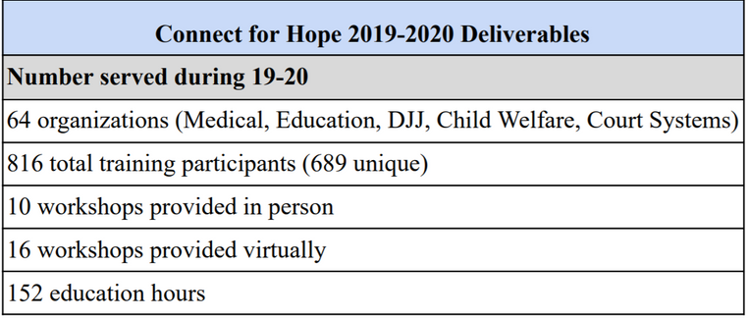

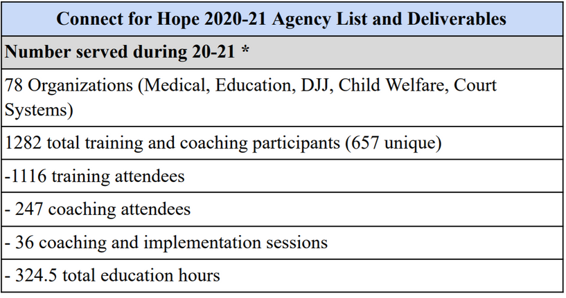


1.
2019 LAUNCH YEAR
Lens, Language, Framework
Kids Hope Alliance, Connect for Hope
Hope Street has partnered with KHA to provide trauma-informed training, coaching, and consultation to community partners and providers serving the most vulnerable children and families in Jacksonville.
2.
2020-2021
3.
2021-2022
We will continue cycling through Phase 1 with new organizations while moving firmly into Phase 2 with existing organizations. (Children & Adults)
Measures: Exploration Phase
Tracking growth through a TIC Lens:
Individual, culturally respectful, multi-voicedness
Presented By Callie Lackey | Hope Street, Inc.

Slide 6
Measuring Progress ….beyond numbers
KEY INDICATOR
ACTIVITY / PROJECT
DATA / OUTCOME
Increase in TIC Knowledge
Increase in TIC Strategies
Pre and Post Workshop
Assessments
The pre-test average was 60%.
The post-test average was 91%.
Tracking growth through a TIC Lens:
Individual, culturally respectful, multi-voicedness.
Increase in Attitudes Related to TIC
(Support)
Hope Organizations
Voluntary
In Progress
  ARTIC Scale
  Adult Resilience Scale
  Survey of Organizational Functioning
Exploration Phase
Funding Required
Yet to be determined
Process will be community facing and collaborative
Creation and Implementation of Human-centered Trauma Informed Data measure and gathering processes
  Themes and patterns of needs and shifts in lens, language, and framework.
  Reflective growth in how stakeholders receive and experience support
  Growth in TIC implementation
  Increase in felt-safety, connection, and regulation

Slide 7
KHA funding support for training and awareness (DCPS FSS Therapists -86) (2019-2020: $50,000)
Ripple
4 District TBRI Practitioners, JPEF Partnership to fully integrate TBRI in schools, SLI/TLI Leadership Institute – TIC Certification, and Pilot Projects launching 2021: Training, Coaching (Principals and Teachers, Crisis Social Workers)
Ripple effect of Systems Change
KHA funding Support
Duval Head Start (2020-2021: $83,333.33)
Ripple
LSF Head Start State Onboarding
Creating a common trauma informed Lens, Language, and Framework.
How do you measure a ripple?
KHA funding support to Hope Organizations (2020-2021: $83,333.33)
Ripple
Pilot Projects
Daniel, FSS, Rethreaded, Child Guidance, DCF
KHA funding support for training and awareness (2020-2021: $83,333.33)
Ripple
TBRI Train the Trainer Program to Jax:
31 Participants to be trained across all systems of care to support TBRI implementation at on organizational level.
KHA funding support for training and awareness (2020-2021: $83,333.33)
Ripple
Creation of Champions, a collaborative network of healing centered partners aiming to reduce burn-out, to deepen TIC practices, to reduce silos, and to share a common framework to meet the needs of the Jacksonville community
KHA BTIJ funding support for training and awareness (2021-2022: $100,000)
Ripple
BTIJ: Building a Trauma Informed Jacksonville initiative.
The aim is to provide the infrastructure and expertise to create a framework, a detailed actionable plan, leadership, outputs, and outcomes to move Jacksonville toward becoming a Trauma Informed Community.

Slide 8



Building a Trauma-Informed Jax
OBJECTIVE 1
Foster Awareness & Culture Change
Create a trauma informed culture of awareness, knowledge, care, safety, and
connection in the entire community (with neighborhood as the centers) and within
provider agencies to bring about education, resolution, and healing of trauma
through messaging and the delivery of customized training to all sectors.
The purpose is to create a trauma informed community of resilience with interconnected systems, authentic community engagement, and inclusivity at the decision-making table.
The aim is to provide the infrastructure and expertise to create a framework, a detailed actionable plan, leadership, outputs, and outcomes for this collaborative community work to move Jacksonville toward becoming a Trauma Informed Community.
OBJECTIVE 2
Prevent and Reduce ACEs and Trauma
Deliver trauma responsive interventions through systemically integrated networks of Prevention, Intervention and Treatment services that will prevent and reduce trauma and ACEs including evaluation activities with measured outcomes.
OBJECTIVE 3
Nurture Learning Communities
Strengthen and widen networks among community members with neighborhoods as the center and engage with professionals from all sectors to share resources, with research around Trauma Informed best practices as the core work.
Presented By Callie Lackey | Connect for Hope

Slide 9


Contact
We thank you for your continued support in our efforts to building a Trauma Informed Jacksonville.
Hope Street, Inc.
P.O. Box 50154
Jacksonviile, FL 32240
904-373-8029
www.hopestreetinc.com
info@hopestreetinc.com
@hopestreetinc

